Slide 2
Background
Sepsis is the body's overwhelming and life-threatening response to infection which can lead to systemic inflammation, tissue damage, organ failure and death.
Sepsis continues to be one of the leading causes of death among critically ill people.
Sepsis is often seen in the respiratory system include respiratory tract, gastrointestinal and genitourinary tract.
Often times can worsen pre-existing conditions.
In 2016 - Sepsis cost = $38 billion

Slide 3
Background
Some of the most vulnerable populations at risk for developing sepsis include:
Older adults
Males
People who are immunocompromised
People with chronic conditions
Blacks/African-Americans

Slide 4
Background
Typically older age presents as a risk factor, however, sepsis impacts all ages from newborns to elderly.
Studies show specifically in neonates, insurance payer status, income, race, and gender were strong indications for increased sepsis mortality.
Despite standardization of care through evidence-based practice bundles, wide disparity among races still exist.

Slide 5
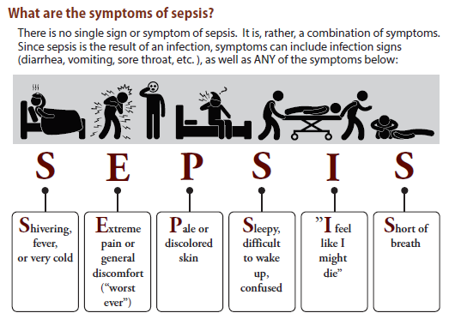
Signs and Symptoms
Notes:
Source: X:\Sepsis Collaborative\NJ Sepsis Legislation\Sepsis Protocols (RWJBHSepsis Education_General 6-18)

Slide 6
Insurance and Sepsis
Many insurance companies started implementing new payment audit policies that do not support early sepsis detection and intervention.
By only covering care that meets the Sepsis 3 definition, this presents a disconnect with CMS and provider recommendations for care.
Sepsis 3 is defined as life-threatening organ dysfunction that may be accompanied by septic shock, further increasing the risk of mortality than with sepsis alone.
Standardized approach to care needs to be a priority for payers so that early sepsis detection can be supported.

Slide 7
Sepsis Self-Management
Taking medications as instructed by your healthcare provider
Eating a healthy diet and drinking enough fluid (water)
Limiting alcohol use
Gradually returning to normal activities as advised by your healthcare provider
Preventing infections by practicing good hygiene
Managing stress in ways such as meditation, breathing exercises and muscle relaxation
Document Released: 07/26/2019 Document Revised: 07/26/2019 Document Reviewed: 07/26/2019 Elsevier Interactive Patient Education © 2020 Elsevier Inc.
Notes:
Source: https://www.elsevier.com/__data/assets/pdf_file/0005/991256/Sepsis,-Self-Care,-Adult_260719.pdf

Slide 8
Sepsis and Health Equity
Racial/Ethnic Disparities in Patient Care and Outcomes
Black patients admitted to the emergency room are assigned to significantly lower priority status and experience significantly longer wait times (10.9 minutes longer on average) as compared to case-matched white patients
Non-Hispanic Black children admitted to the emergency room are less likely to be treated for sepsis than non-Hispanic white children
Preliminary research in a rural emergency department serving a Native American population found that 27.9% of admissions and transfers met sepsis criteria, higher than the 6% average for U.S. hospitals
Limited English proficiency is associated with an 80% higher mortality risk among sepsis patients
Notes:
References
Schrader, C. D. and Lewis, L. M. (2013) Racial disparity in emergency department triage, J Emerg Med, 44(2), 511-518.
Raman, J., Johnson, T. J., Hayes, K. and Balamuth, F. (2019) Racial Differences in Sepsis Recognition in the Emergency Department, Pediatrics, 144(4), e20190348.
Bakalli, H., Close, R., & Kellywood, K. (2020). SEPSIS IN THE NATIVE AMERICAN POPULATION. Chest, 158(4), A707.
Jacobs, Z. G., Prasad, P. A., Fang, M. C., Abe-Jones, Y. and Kangelaris, K. N. (2019) The Association between Limited English Proficiency and Sepsis Mortality, Journal of Hospital Medicine, 14, E1-E7.
Rhee, C., Dantes, R., Epstein, L., Murphy, D. J., Seymour, C. W., Iwashyna, T. J., ... & Jernigan, J. A. (2017). Incidence and trends of sepsis in US hospitals using clinical vs claims data, 2009-2014. JAMA, 318(13), 1241-1249.

Slide 9
Implicit Bias in Healthcare
Patient-provider relationships
Specific conditions (obesity, STIs, HIV, Maternal Health)
Vulnerable populations
Sexual & gender minorities
People with mental health and substance use disorders
Older adults
Medical research.
Notes:
Source: https://www.elsevier.com/__data/assets/pdf_file/0005/991256/Sepsis,-Self-Care,-Adult_260719.pdf

Slide 10
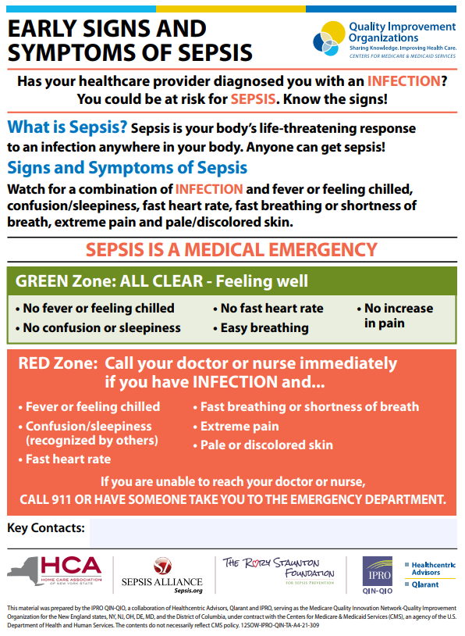
Sepsis Recap
Notes:
Source: https://qi.ipro.org/wp-content/uploads/12SOW-EarlySignsSymptoms-Sepsis_v1.pdf

Slide 11
Resources
http://www.njha.com/CQI/njtools/sepsis/
http://www.njha.com/CQI/njtools/sepsis/ob-sepsis/
NJHA Toolkit for Post-Acute Care Settings
NJHA Sepsis Patient Education
NJHA Sepsis Patient Education (Spanish)
Surviving Sepsis Campaign
Educational resources
Sepsis Alliance
Patient and family resources
Educational resources for Spanish-speaking patients and families
Surviving Sepsis Campaign: International Guidelines for Management of Severe Sepsis and Septic Shock: 2016
Centers for Disease Control and Prevention Sepsis Information

Slide 12
QUESTIONS?

Slide 13
Contact
Sandy Cayo, DNP, FNP-BC
Vice President of Clinical Performance and Transformation
New Jersey Hospital Association
760 Alexander Road, PO BOX 1
Princeton, NJ 08543-0001
Phone: (609) 578-0722
E-mail: scayo@njha.com

