Slide 2
To care for others, you must first care for yourself.

Slide 3
Introducing Nurse2Nurse, a Peer Support Program For Nurses, by Nurses

Slide 4
Stressors Facing Today’s Nurses
COVID-19 burnout & compassion fatigue
Grief & guilt
Work-life balance
Workforce shortages
Overtime
Racism & other forms of bias
Harassment

Slide 5
About Nurse2Nurse
A program of Rutgers University Behavioral Health Care and New Jersey Nursing Initiative (NJNI)
Funding provided by the N.J. Pandemic Relief Fund and NJNI, a program of the Robert Wood Johnson Foundation in collaboration with the New Jersey Hospital Association
Not affiliated with any nursing licensing organization or hospital, health system or other healthcare facility

Slide 6
Peer Support Model
Confidential, empathic, non-judgmental
Staffed by active and retired nurses trained in reciprocal peer support and wellness principles
Developed by Rutgers University National Center for Peer Support
Used successfully with other frontline workers including veterans and law enforcement

Slide 7
Focus on Wellness

Slide 8
Peer Support Outcomes
Increased self-esteem and confidence
Greater sense of control
Improved self-care
Increased sense of hope

Slide 9
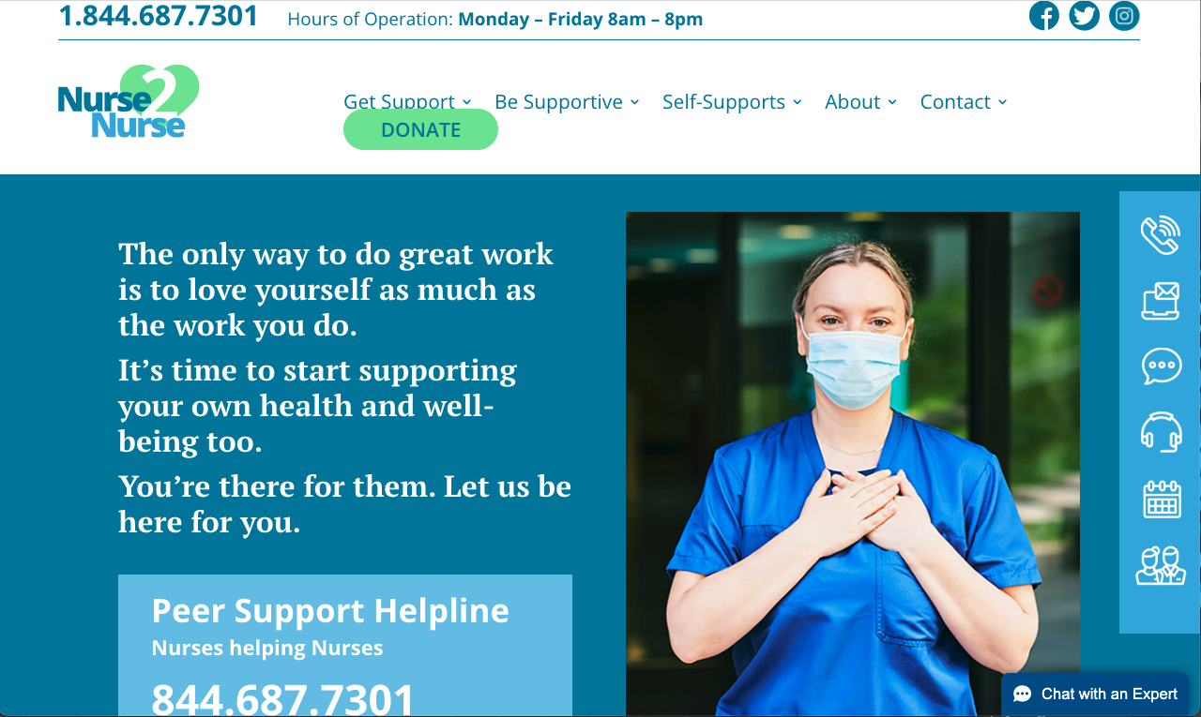
Nurse2Nurse Resources
Live toll-free helpline 1-844-687-7301
One-on-one peer support
Online chats
Virtual support groups
Wellness webinars

Slide 10
Let’s Connect, Nurse to Nurse!
Visit the Nurse2Nurse website www.nurse2nurseNJ.com
Call the toll-free helpline 1-844-687-7301, M-F, 8 am to 8 pm
Request an online chat, email or return call www.nurse2nurseNJ.com/talk-to-us

