Slide 1
Strategies for Maintaining Your Emotional Well Being
Danielle Lambert, LCSW
Behavioral Health Manager

Slide 2
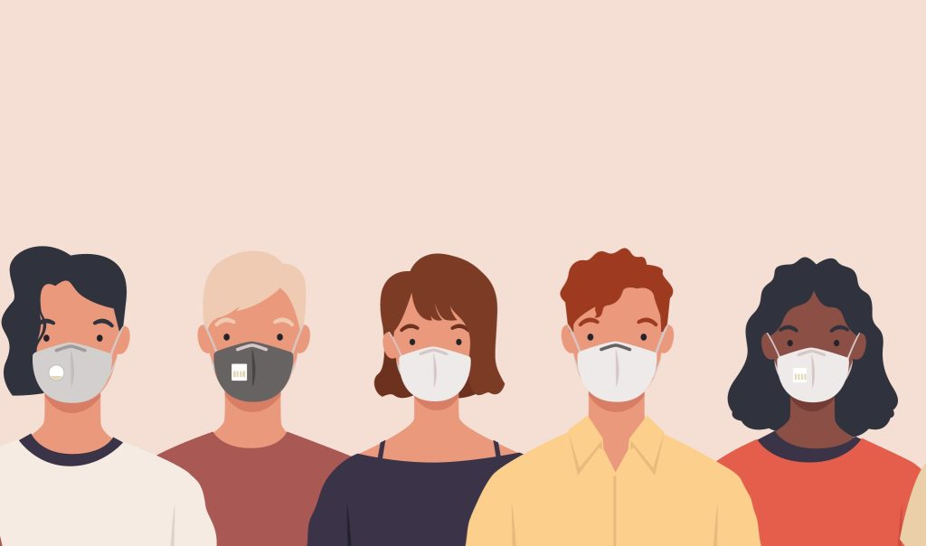

Slide 3
COVID-19: Grief in Stages
We Tell Ourselves:
Denial: This virus won’t affect us.
Anger: You’re making me stay home and taking away my activities.
Bargaining: If I social distance for two weeks everything will be better, right?
Sadness: I don’t know when this will end.
Acceptance. This is happening; I have to figure out how to proceed.
***Not Always Linear***
Source: Harvard Business Review

Slide 4
Anticipatory Grief = Anxiety
Anticipatory grief is that feeling we get about what the future holds when we’re uncertain.
Focusing on future events and imagining the worst case scenario.
COVID-19:
What if I get sick?
What if my loved ones get sick?
What if I lose my job?
What if I spread the virus to someone I love?
What if I never get to see my family?

Slide 5
Surge Capacity: Where do we go from here?
Surge Capacity is a collection of adaptive systems-mental and physical-that humans draw on for the short-term survival in acutely stressful situations, such as natural disasters – Ann Masten, PHD
Reaching Our Limit

Slide 6
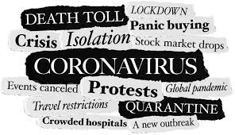

Slide 7
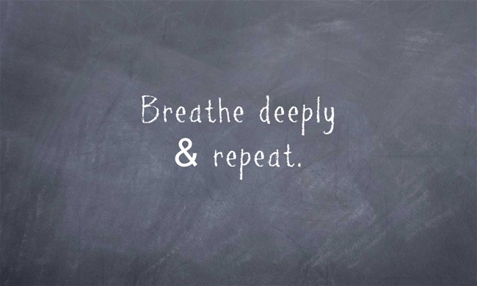

Slide 8
Acceptance and Self-Care
Mindfulness:
Be in the Present: What is actually happening right now?
Let go of what you cannot control
(Hint: It’s probably what you’re worrying about!)
Breathe: Deep breathing, relaxation exercises
Nature: Take breaks, spend time outdoors, notice what is around you
Self-Compassion: Be kind to yourself and others
Meditation Apps: Calm, Headspace, Ten Percent Happier

Slide 9
Acceptance and Self-Care
Physical Well being
Get outside! Walk, Hike, Run, Bike
Yoga
Online exercise classes
Dance
Sleep

Slide 10
Acceptance and Self-Care
Nutritional Well being
Stay Hydrated
Make Healthy choices
Cook meals together

Slide 11
Acceptance and Self-Care
Emotional Well being
Stay Connected
Read
Meditate
Listen to Music
Laugh
Play
Celebrate

Slide 12
Englewood Health: Behavioral Health Services
https://www.englewoodhealth.org/service/behavioral-health-and-psychiatry
Emotional Health Resources
NJ HOPELINE
1-855-654-6735
www.njhopeline.com
NATIONAL SUICIDE PREVENTION LIFELINE
1-800-273-TALK (8255)
www.suicidepreventionlifeline.org
2NDFLOOR YOUTH HELPLINE
1-888-222-2228
www.2ndfloor.org
24 hours a day – 7 days a week

