Slide 1
WHAT IS MEDICAL AID-IN DYING?
Medical Aid-In Dying (MAID) is when a terminally ill, mentally capable person who has a prognosis of six months or less requests, obtains and – if their suffering becomes unbearable – self-ingests medication that brings about a peaceful death.
MAID is a recognized medical practice in eight American jurisdictions requiring doctors to inform terminally ill patients about the full range of end of life care options prior to writing a prescription for aid-in dying.
MAID is not suicide nor assisted suicide. People seeking MAID are near the end of a terminal illness, suffering and deliberate in their decision making.
‹#›

Slide 2
MEDICAL AID-IN DYING LAWS
MAID is a safe and trusted medical practice authorized in eight jurisdictions.
    Oregon (1994), ballot initiative
    Washington (2008), ballot initiative
    Montana (2009), state supreme court decision
    Vermont (2013), legislation
    California (2015), legislation
    Colorado (2016), ballot initiative
    Washington, DC (2016), legislation
    Hawaii (2017), legislation
    New Jersey (2019), legislation (pending Governor’s signature)
Legislation is being considered in 25 states.
‹#›

Slide 3
NEW JERSEY LEGISLATION
Assembly Bill 1504 / Senate Bill 1072
Previous versions of the bill were approved by the New Jersey General Assembly in
      2016: 41-29-5
      2014: 41-31-0
Released from the Assembly Judiciary Committee on March 12, 2018
Released from the Senate Health Committee on February 7, 2019
Approved by Assembly and Assembly on March 25, 2019
Bi-partisan support
Signed in to law April, 2019; Effective August 1, 2019
‹#›

Slide 4
ELIGIBILITY FOR AID-IN DYING – NJ LEGISLATION
Terminally ill adult resident of New Jersey (terminal stage of a fatal condition)
Prognosis of six months or less
Mentally capable
Able to self-ingest medication
Patient voluntarily expresses their decision to request a prescription
Patient originates a written request to their treating physician; form in law
Request must be witnessed by at least two individuals attesting to the patient’s competence and voluntary desire; form in law
‹#›

Slide 5
ELIGIBILITY FOR AID-IN DYING, – NJ LEGISLATION, CONT’D
At least one witness must be disinterested
A consulting specialist physician shall verify the patient’s eligibility
Either physician may refer the patient to a psychiatrist or psychologist if there is any question as to mental competency
The patient must make two oral requests to their treating physician with a 15 day waiting intervening waiting period
The physician must make an offer to rescind the request. A patient may rescind their request at any time and in any manner
Treating physician must refer patient to a qualified health care professional to discuss end of life options (palliative care, hospice, pain control options
‹#›

Slide 6
PATIENT’S MEDICAL RECORDS MUST INCLUDE
The basis for determining the patient is qualified terminally ill patient
All oral and written requests must be documented
Treating physician's diagnosis and prognosis and determination that the patient is capable, informed and acting voluntarily
Consulting physician's diagnosis and prognosis and determination that the patient is capable, informed and acting voluntarily
If applicable, determination by psychiatrist or psychologist
Documentation of treating physician's referral to end of life options consulting
Treating physicians offer to rescind the patient’s request
Treating physicians confirmation that all criteria have been met (or not)
‹#›

Slide 7
OTHER PROVISIONS IN NJ BILL
No contract (life insurance or other agreement may validly restrict or impact a person’s decision regarding MAID)
Life insurance cannot be conditioned in any way upon MAID decision making
Clarifying that MAID is not assisted suicide under the laws of this state
No impact to the applicable standard of care provided by health care providers
No person may act for another
No person shall have criminal or civil liability or professional disciplinary action taken for good faith compliance with the provisions of this law or for refusing to participate
‹#›

Slide 8
OTHER PROVISIONS IN NJ BILL, CONT’D
Participation by any health care professional and any health care facility shall be voluntary on their part
Intentional violation of the law is criminal
The duty to warn is not incurred when a qualified terminally ill patients makes an MAID request
Actions taken in conformity with this law do not constitute suicide of assisting with suicide.
‹#›

Slide 9
20 Years of Practice in Oregon Show that Medical Aid in Dying Works as Intended
Having a prescription for aid-in-dying medication on hand is a comfort.
People use the law to minimize suffering, not to save money.
The elderly, people with disabilities and people of color have not been coerced or abused.
Notes:
20 years of data from Oregon, and 40 years of combined data from all the authorized states, demonstrates that the law works as intended.
The evidence and data dispels the myths. None of the concerns or fears that opponents have raised have occurred.
Instead the data shows:
Medical aid in dying is a compassionate medical practice. Simply having a prescription for aid-in-dying medication on hand is a comfort to dying people and allows them to live their remaining days to the fullest even if the ultimately choose not to self-administer the medication.
People use the law to minimize pain and suffering, not to save money.
There has never been a single instance of abuse in a combined thirty years of authorized medical aid in dying. The elderly, people with disabilities and people of color have not been coerced into using the law.

Slide 10
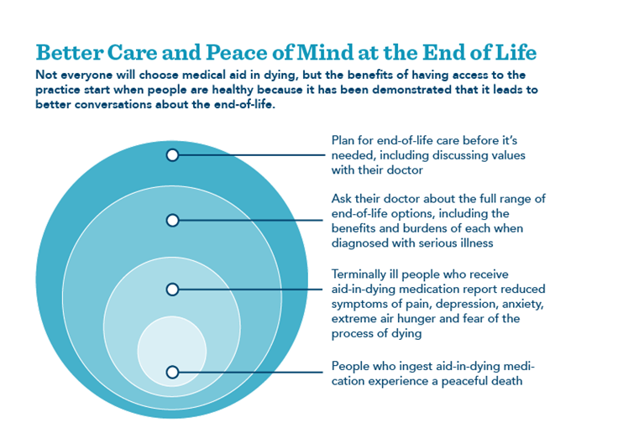

Slide 11

Having a Prescription for Medical Aid-in-Dying Medication Is a Comfort
Only 65% of the 1,967 prescriptions written between 1998 and 2017 in Oregon were ingested.
Notes:
Simply having a prescription for medical in dying medication has an important palliative and comfort effect for dying people because it allows them to live their remaining days to the fullest without worrying about pain or suffering..
About a third of people who obtaining prescriptions do not end up taking them.

Slide 12
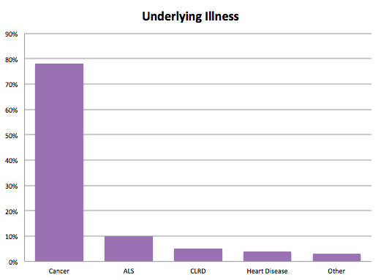
Diagnosis of People Who Requested Aid-in-Dying Medication in Oregon
Notes:
Oregon Public Health Division 20 year data show that the underlying illnesses were broken down as follows:
Malignant neoplasms: 78 percent
ALS: 10 percent
CLRD: 5 percent
Heart Disease: 4 percent
Other illnesses: 3 percent

Slide 13
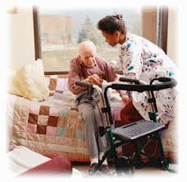
Hospice and Palliative Care Are Improved and Better Utilized
90% enrolled in hospice
93% died at home
Notes:
In Oregon, 90 percent of people who used the law were enrolled in hospice and 93 percent died at home.
In fact, the article, Geographic Variation in Hospice Use Patterns at the End of Life, found that those at the end of their lives in Oregon have benefited from improved care as measured by clinical standards, increased referrals to hospice, and the experience of hospice nurses. This is due in part to the dialogue that authorization of medical aid in dying encourages between people and their doctors, better palliative care training for physicians and more hospice care referrals.
Citation: Vol. 34 No. 3 September 2007 Journal of Pain and Symptom Management 277
Geographic Variation in Hospice Use in the United States in 2002 Stephen R. Connor, PhD, Felix Elwert, PhD, Carol Spence, RN, MSN, and Nicholas A. Christakis, MD, PhD National Hospice and Palliative Care Organization (S.R.C., C.S.), Alexandria, Virginia; and Department of Health Care Policy (F.E., N.A.C.), Harvard Medical School, Boston, Massachusetts,
[Inappropriate hospice use defined as very short enrollment, very long enrollment, or disenrollment.]

Slide 14
Concerns Oregon Patients Have which Lead to Request Medical Aid-in-Dying Medication
90% | Less able to engage in activities that make life enjoyable (quality of life)
91% | Loss of autonomy
Notes:
Patients in Oregon request a prescription primarily due to concerns of loss of quality of life and autonomy and often leave the prescription unfilled at the pharmacy as a comfort measure unless their suffering becomes unbearable.

Slide 15
Challenges
Federal Insurance
Health System policies
Regulations vs Resident Rights
Pharmacies

Slide 16
Resources
Videos for Patients and Physicians
Fact Sheets
Sample Policies
Webinars and Presentations
Technical Support
End of Life Consultation

