Slide 1
Improving Antibiotic Use in Older Adults
Morgan Katz, MD MHS
Assistant Professor of Infectious Disease

Slide 2
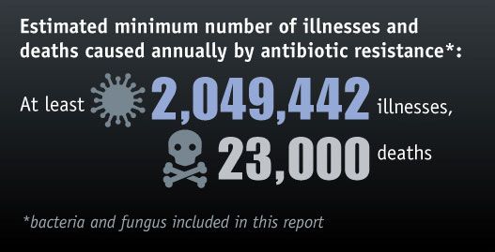
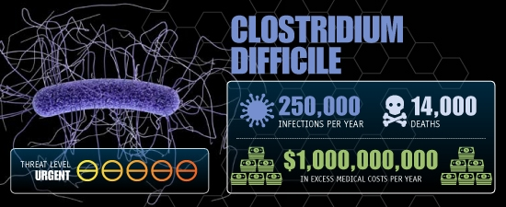
Antibiotic resistance is an urgent threat
CDC Report "Antibiotic Resistance Threats in the United States, 2013
https://www.slideshare.net/trufflemedia/dr-larry-granger-usda-antimicrobial-resistance-strategy

Slide 3
Antibiotics are vastly over-prescribed to older adults
Clostridium Difficile Infection
Liver injury
Kidney injury
Rash
Nausea/Vomiting
Notes:
Reviews of antibiotic use in nursing homes show that up to 70 percent of antibiotic courses prescribed in nursing homes are considered unnecessary or not concordant with guidelines.
On top of this, over half of residents in a nursing home setting are prescribed at least one course of antibiotics within a 3 month period.
The problem is, older adults are particularly at risk for the many side effects that come with antibiotic use, including GI side effects, kidney injury, which is a big one in older adults who generally have reduced kidney functioning, Clostridium difficile infection, which carries high mortality rates in older adults, liver injury, or rash.

Slide 4
Antibiotic Exposure Leads to Resistance and Alters the Microbiome
Notes:
While in the past we thought antibiotics “can’t hurt” and may prevent worsening infections, we are now learning that antibiotic exposure can cause many downstream effects. – these effects can last for weeks to even months after the antibiotic exposure.

Slide 5
We are Rapidly Losing Antibiotic Options
Notes:
This is a major public health issue- while we are working on making new antibiotics, there is no way we can create enough new antibiotics at the rate that the bacteria are developing resistance to them.
This realization has led to a recent push to enhance antibiotic stewardship efforts.

Slide 6
What is Antibiotic Stewardship?
Appropriate use of antibiotics
Right drug
Right dose
Right indication
Right duration
Notes:
What do we mean by antibiotic stewardship?
The goal of antibiotic stewardship, which historically has been led by an ID trained pharmacist or infectious disease specialist, is to facilitate appropriate use of antibiotics. By that we mean, the right drug, at the right dose, for the right reasons, for the correct amount of time. And no, this does not mean taking antibiotics for a cold. Remember, the cold is a virus, and antibiotics will not treat this!

Slide 7
http://www.darkcloudblogs.com/2017/09/inside-character-sheet-steward.html
https://twitter.com/ABsteward
Oxford Biosystems
Notes:
Antibiotic stewards in the past have gotten a bad reputation-
Many doctors in the hospital setting, and likely across the healthcare setting, saw antibiotic stewards as these villains, coming in and slashing their right to prescribe antibiotics to patients that may desperately need them/
Here is how we may have seen ourselves- heros coming in, guiding the physician about appropriate use, protecting public health as a whole and the patient from unnecessary side effects.
We need to come together and make antibiotic stewardship a collaborative effort, with an overarching goal of patient safety, in order to make stewardship programs effective.

Slide 8
Technical problems and solutions
Computer shuts down→ Call tech support
Water leaking in a house→ Call a plumber
**Assign the problem to an expert, and get out of the expert’s way**
Inappropriate antibiotic prescribing→ NOT AN EASY FIX
Notes:
The way antibiotic stewardship has been approached in the past has typically been as a technical problem
Consider some technical problems: your computer shuts down, you call tech support and ask them to fix it. There is water leaking in your house, you call a plumber. The basis behind these technical problems is that you can basically call an expert, and get out of the experts way so they can come fix the problem.
We have been approaching antibiotic stewardship as a technical problem in the past, but this has not worked, and the reason for this is that stewardship is not an easy fix like this. There are so many underlying social motivations and clinical factors that must be considered in order to guide appropriate use.

Slide 9
Vague clinical symptoms
Belief that you are preventing sepsis
Staff Turnover
Unclear guidelines
Off-site prescribers
Inappropriate Antibiotic Prescribing
Fear of litigation
No time for education
Family Pressure
Poor communication
No support from executives
Limited diagnostic resources
Notes:
Consider all of these factors that may influence the prescriber and lead to inappropriate antibiotic prescribing

Slide 10
“The most common cause of failure in leadership is produced by treating adaptive challenges as if they were technical problems.”
-Ron Heifetz
The Practice of Adaptive Leadership
Notes:
Technical problems, as we discussed before, are typically relatively straightforward with an easy fix- you call in an expert and they fix a straightforward problem
Adaptive problems, on the other hand, are not an easy fix. These require a culture change as well as learning by both the expert and the person with the problem.

Slide 11
Reframe the Landscape.
Notes:
Our suggestion here is to reframe the landscape- look at antibiotic stewardship as a patient safety issue, as an adaptive problem that needs to be addressed through a collaborative, rather than a prescriptive, effort.
Antibiotic stewardship as a patient safety issue.
We all must be antibiotic stewards to protect our residents.

Slide 12
Patient Safety Becomes a Priority
TeamSTEPPS program released
To Err is Human published
DoD implements a patient safety program
CUSP program developed and released
Joint Commission established its National Patient Safety Goals (NPSGs) program
2011
2006
2002
2001
2000
Notes:
The idea of patient safety in the healthcare spectrum is actually relatively recent.
The patient safety initiative was prompted by Linda Kohn’s 2000 publication, to err is human, which showed that medical errors cause up to 98,000 deaths annually
DoD’s military health system implemented a patient safety program
2002- joint commission established its national patient safety goals program to help accredited organizations address specific areas of concern in regard to patient safety.
2006- data from TeamSTEPPS program released- AHRQ and DoD released Team Strategies and Tools to Enhance Performance and Patient Safety (TeamSTEPPS™) as the national standard for team training in health care
2011- CUSP program developed and released by AHRQ to address healthcare associated infections including central line infections and CUSP. CUSP dovetails with and supports a range of quality and safety improvement models.

Slide 13
What we have learned
Education alone does not work
Long term care is a nursing-led field
Tools (technical solutions) may help, but only if they are part of nursing workflow
Prescriber feedback is helpful if collaborative
Katz et al, CID 2017
Notes:
In order to prepare for this new initiative, we performed a review of the antibiotic stewardship interventions that have been implemented in long term care.
And evaluated their successes and failures.
Interventions need to be multi-disciplinary
If we don’t address time constraints and limited resources, tools will not be used
Addressing both technical and adaptive issues to change the culture

Slide 14
Hypothesis: Merging patient safety methodology with technical antibiotic stewardship tasks will promote behavior change and enhance antibiotic stewardship methods across the healthcare spectrum.
https://thenextweb.com/wp-content/blogs.dir/1/files/2010/08/idea_bulb.jpg
Notes:
So the hypothesis behind our entire initiative is…
We know there is a need to change the culture of antibiotic prescribing, and Traditional practices have not engaged frontline providers and have not taken in to account local culture or beliefs.
PI’s sara cosgrove and pranita Tamma came up with an idea based on this new direction.
The AHRQ antibiotic safety project was born from this idea- it is a National project reframing the idea of antibiotic stewardship through the lens of patient safety.

Slide 15
National AHRQ Safety Program for improving antibiotic use
Spans the healthcare spectrum
250-500 Acute Care Sites
December 2017 - November 2018
250-500 Long-Term Care Sites
December 2018 – November 2019
250-500 Ambulatory Care Sites
December 2019 – November 2020

Slide 16
What Is the AHRQ Safety Program?
Collaborative intervention
AHRQ
Johns Hopkins Medicine
NORC
Overarching goal
To improve antibiotic prescribing practices and assist facilities with implementing effective antibiotic stewardship programs.

Slide 17
Participating in the AHRQ Safety Program
One-year program begins in December 2018
FREE TO PARTICIPATE
Facilities with and without existing stewardship programs are welcome to join
Continuing medical education (CME) credits and continuing education units (CEU) available for physicians and nurses

Slide 18
Benefits of Participating
Access to antibiotic stewardship experts for coaching and troubleshooting
Monthly interactive Webinars
25 minutes long
Recorded and posted to the project Web site for 24/7 access
Slides and facilitator guides available for local use
Coaching calls
Optional calls for additional assistance
Once a month

Slide 19
More Benefits of Participating
Access to—
Tools to improve antibiotic prescribing practices and communication
Educational material for patients and families
Materials to assist with compliance with Centers for Medicare & Medicaid Services (CMS) mandates
Certificates denoting active participation in the AHRQ Safety Program for Improving Antibiotic Use

Slide 20
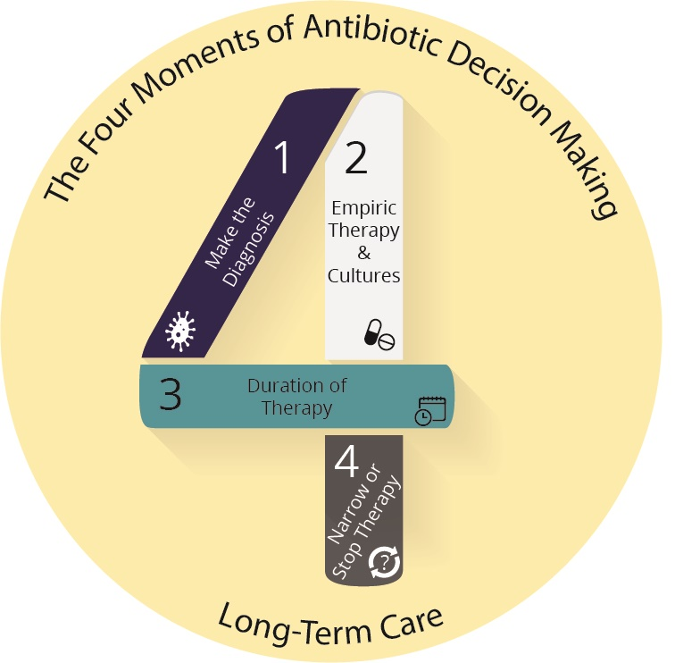
The Four Moments of Antibiotic Decision-Making
1. Does the resident have symptoms that suggest an infection?
2. What type of infection is it? Have we collected appropriate cultures before starting antibiotics? What empiric therapy should be initiated?
3. What duration of antibiotic therapy is needed for the resident’s diagnosis?
4. Re-evaluate the resident and review results of diagnostic tests. Can we stop antibiotics? Can we narrow therapy?

Slide 22
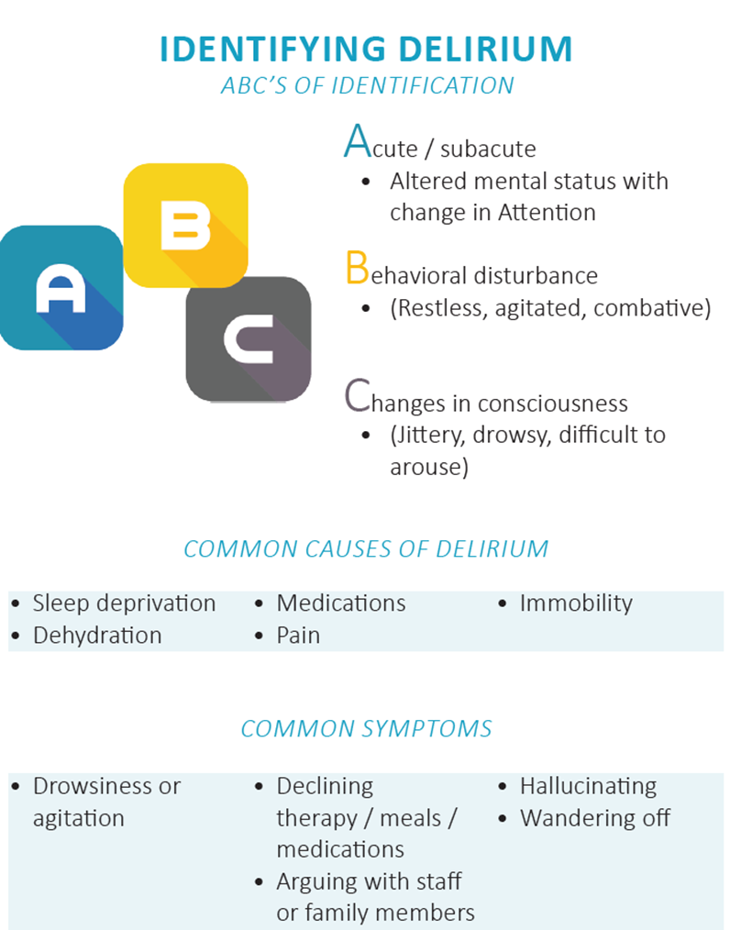
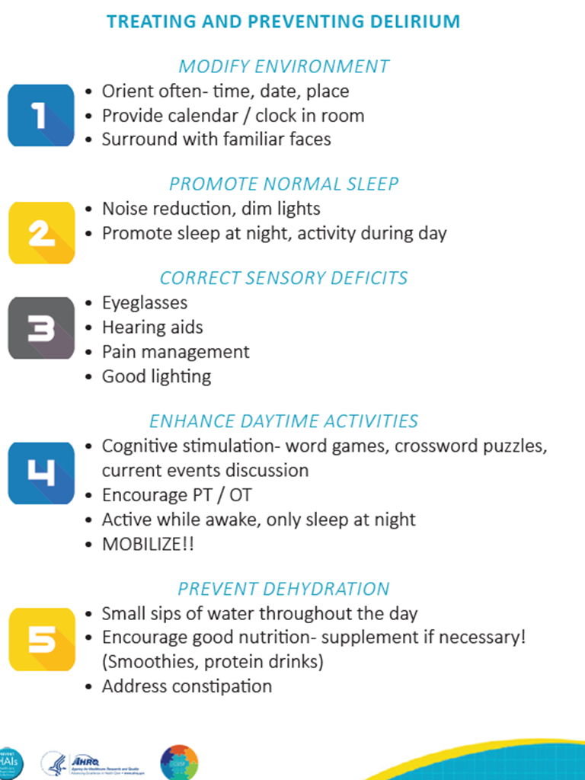

Slide 23
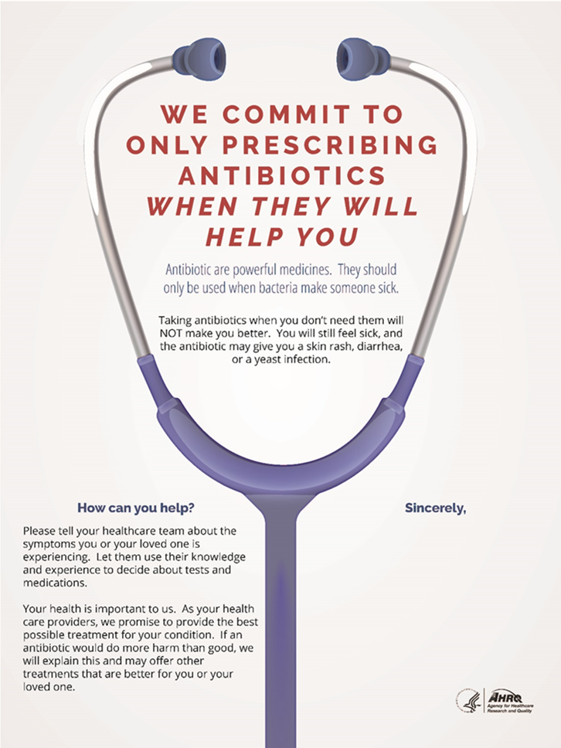

Slide 24
Long-Term Care Webinars
Adaptive Topics
Improving antibiotic use is a patient safety issue
Improving communication and teamwork around antibiotic prescribing
Engaging a senior executive
Changing the system to improve antibiotic use
Developing an action plan to improve antibiotic safety
Sustaining antibiotic stewardship program

Slide 25
Long-Term Care Webinars
Technical Topics
Antibiotic stewardship program development
Appropriate collection of urine and respiratory specimens
Diagnosis and management of urinary tract infections
Diagnosis and management of respiratory tract infections
Communication with providers about infectious concerns
Communication with family members about infectious concerns

Slide 26
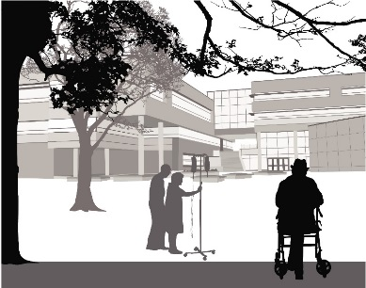
What Do Participating Facilities Need To Do?
Identify the antibiotic stewardship team
Identify and engage frontline staff as part of the team
Participate in monthly Webinars with experts
Between Webinars, identify areas to improve antibiotic prescribing and incorporate relevant tools into practice
Submit requested data to the program Web site

Slide 27
Data Required From Participating Facilities
Monthly data on days of antibiotic therapy per 1,000 resident days for antibiotics commonly used in the long term care setting
Monthly data on number of antibiotic starts per 1,000 resident days
Quarterly C. difficile laboratory events per 10,000 patient-days
Quarterly urine cultures per 10,000 resident days

Slide 28
Expected Outcomes
Improved safety culture around antibiotic prescribing.
Enhanced teamwork and communication
Reduced unnecessary antibiotic use.
Improved antibiotic decision-making
Reduced Clostridium difficile infection rates.
Improved compliance with CMS regulations
Notes:
We have recently completed a pilot study of 6 nursing homes in the area, and are compiling data from the pilot at this time. The national roll out for long term care will start in December 2018.
The government has addressed this as an urgent threat- and antibiotic stewardship is now required in long term care facilities- this is a potential answer to the dilemma regarding how to formulate and sustain these interventions.

Slide 29
To Learn More and Enroll
Visit AHRQ Web site:
https://safetyprogram4antibioticstewardship.org/
Complete the online application on the Web site
Email antibioticsafety@norc.org with any questions
Notes:
Fliers will be available with more information and distributed throughout conference

