Slide 1

New Jersey
Antimicrobial Stewardship Learning Action Collaborative
July 25, 2018

Slide 2
Partners in Collaboration
Administrative Leadership:
  NJHA Institute for Quality and Patient Safety
Aline Holmes, DNP, MSN, RN
Shannon Davila, MSN, RN, CIC, CPHQ
Dara Elkholy, BSPH
Clinical Leadership: Jefferson Health (New Jersey division)
Cindy Hou, DO, MA, MBA, FACOI, FACP
Marianne Kraemer, RN, MPA, ED. M., CCRN
David Condoluci, DO, MSc., and MACOI
Collaborative facilities include acute care, long term acute care, post-acute care facilities

Slide 3
Partners from Across New Jersey and Nationally
New Jersey Department of Health
QIO- Healthcare Quality Strategies Inc.
Centers for Disease Control and Prevention
Ernest Mario School of Pharmacy
Ronald G Nahass, MD, MHCM – President ID Care
Quality Insights Renal Network 3
New Jersey APIC chapters
Partners from Long Term Care

Slide 4
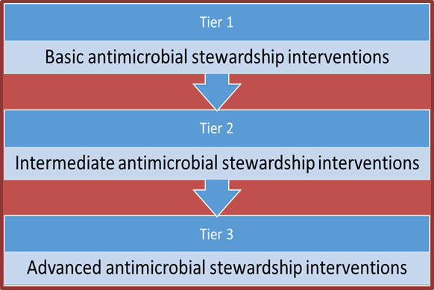
Tiered Approach to Implementation of Practices
Tier 1 “Basic Antimicrobial Stewardship Interventions”
Tier 2 “Intermediate Antimicrobial Stewardship Interventions”
Tier 3 “Advanced Antimicrobial Stewardship Interventions”
Currently we are focused on Tier 2- Intermediate Interventions
These are more complex than basic, and require more resources and coordination to implement

Slide 5
Hot Topics for 2018
Stewardship Issues and Examples of Innovation

Slide 6
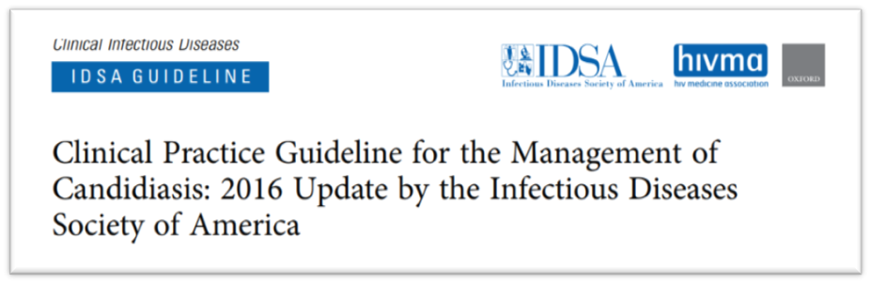
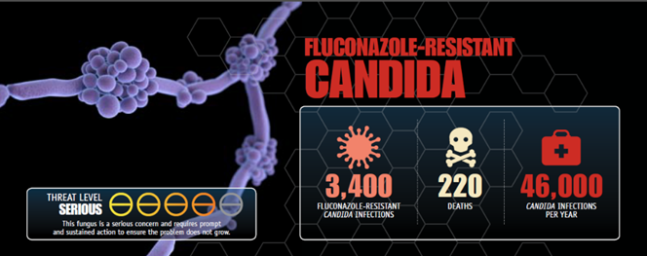
Focus on Fungal Infections
In January CDC presented on the importance of antifungal stewardship
Highlighted importance of proper diagnosis and treatment of drug resistance fungal infections
First step in antifungal stewardship is antibiotic stewardship: to prevent fungal infections

Slide 7

Sepsis and Antibiotic Stewardship
In February, CDC and JH-NJ presented on the relationship between sepsis and ABS stewardship.
Antibiotic Stewardship Program can be a resource for the ED, ICU, and other providers managing patients with sepsis.
Every patient gets optimal antibiotic treatment for sepsis
  As soon as possible
  The right antibiotic(s)
  At the right dose
  For the right duration
When more information available, antibiotics tailored and/or de-escalated.

Slide 8
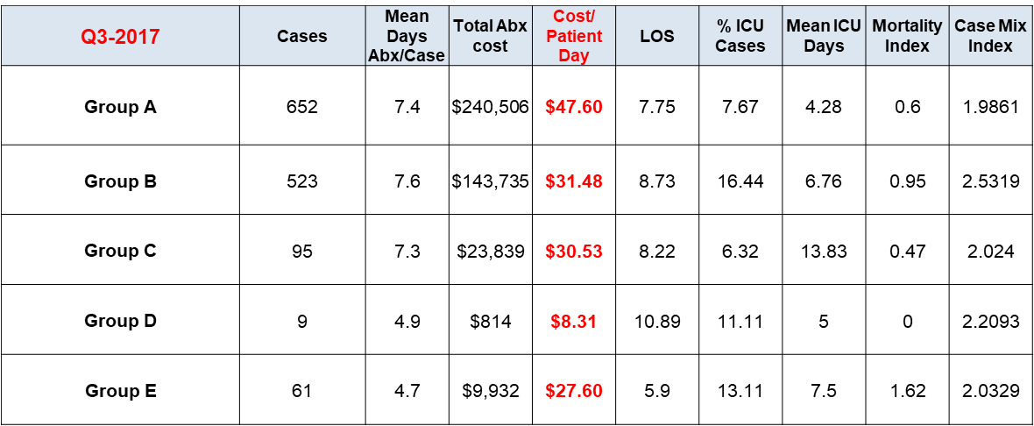
Using Provider Level Data to Drive Change
In April, Atlantic Health Stewardship Team presented on their use of provider level scorecards
Checklist for Core Elements of Hospital Antibiotic Stewardship Programs
  “Do prescribers ever receive direct, personalized communication about how they can improve their antibiotic prescribing?”
  Anecdotal experience that antimicrobial utilization and cost varied considerably among ID consultants

Slide 9
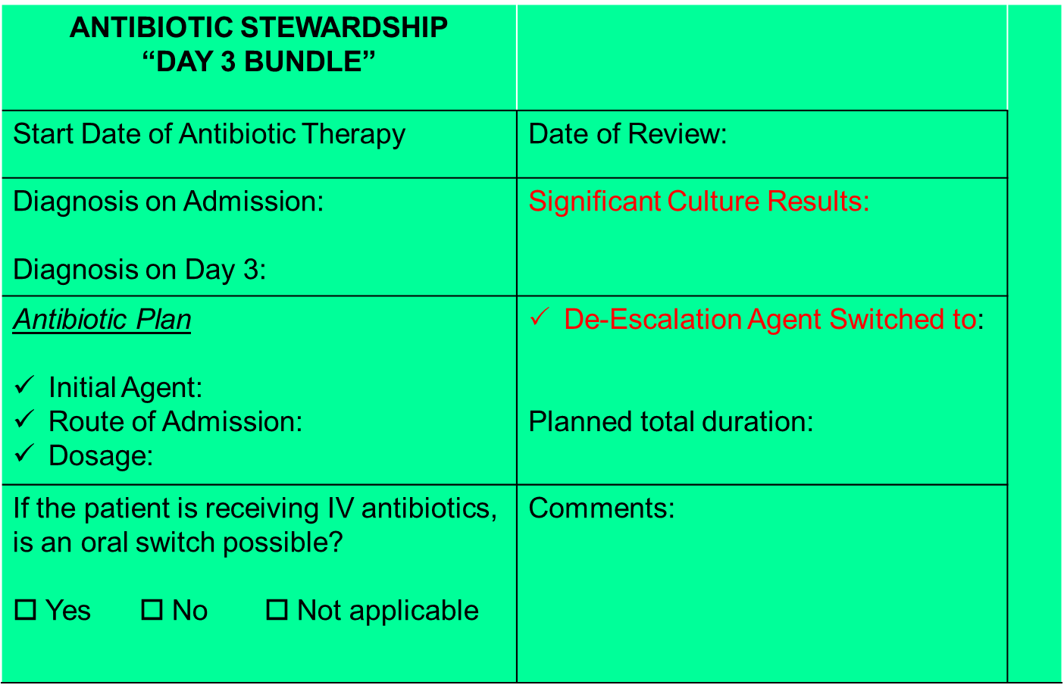
Engaging Medical Staff to Improve Stewardship
In May, Capital Health presented their approach to engaging physicians through a multidisciplinary approach to stewardship.
Their study sought to improve the practice of antibiotics used in the inpatient setting through an effective, physician-led, multidisciplinary antimicrobial stewardship initiative in a community- based teaching hospital.
Their pilot program showed that when physicians stop and rethink their antibiotic use at day 3, they are more likely to make interventions that lead to shortened duration of broad spectrum antibiotics and statistically significant decreased LOS.

Slide 10
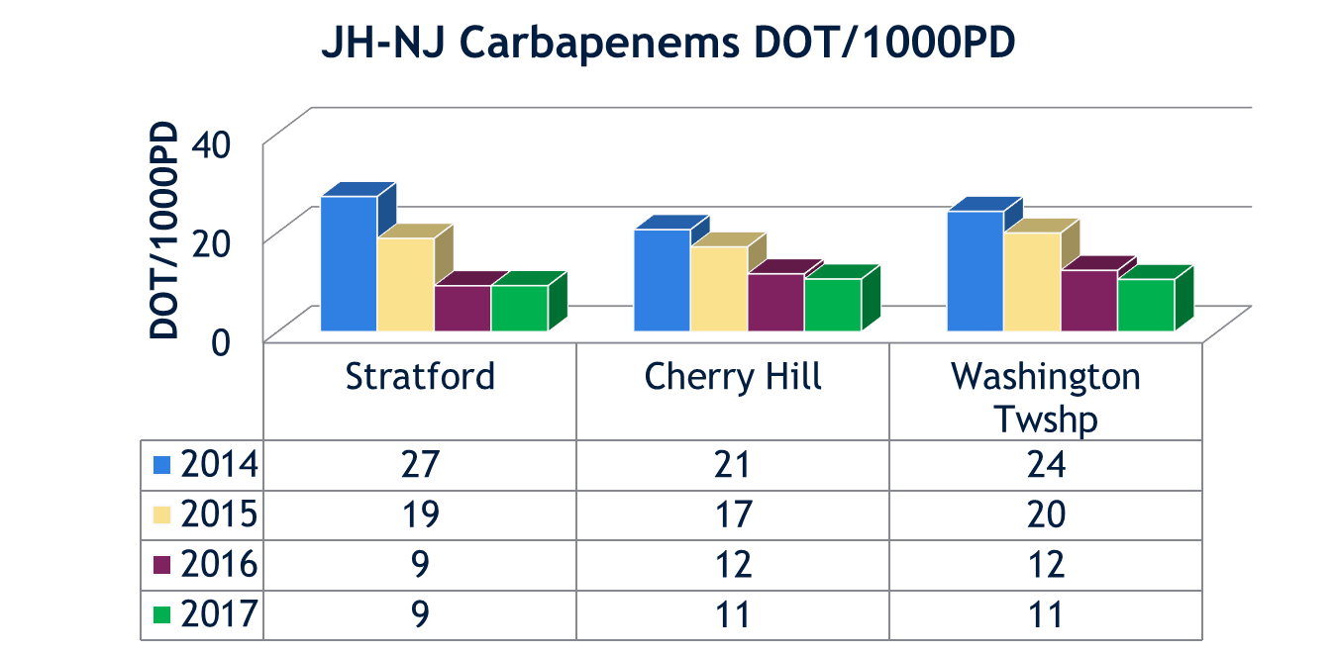
Prospective Audit and Feedback vs.
Preauthorization with Restrictions
In June, the JH-NJ Antibiotic Stewardship Team presented on how prospective audit with feedback and Preauthorization with restrictions have been proven to be effective core ASP strategies
Prospective audit and feedback is likely to increase visibility of the ASP and build collegial relationships.
Preauthorization has shown to be less labor intensive and less time consuming.
The most successful method is incorporating both strategies into an Antimicrobial Stewardship Program.

Slide 11
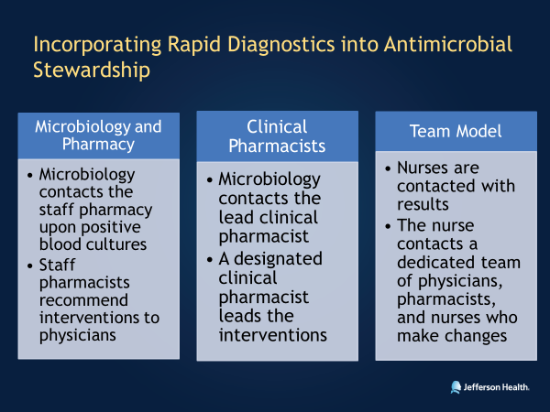
Role of Rapid Diagnostics in Bloodstream Infection
Also on the June webinar, the JH-NJ team discussed the role of rapid diagnostic testing (RDT) in bloodstream infections.
The implementation of RDT led to:
  Faster organism identification and microbiological cure
  Increased rates of appropriate therapy from time of blood culture draw
  Decreased LOT and direct cost savings in Post-RDT group

Slide 12
2018 Practice Assessment Highlights

Slide 13
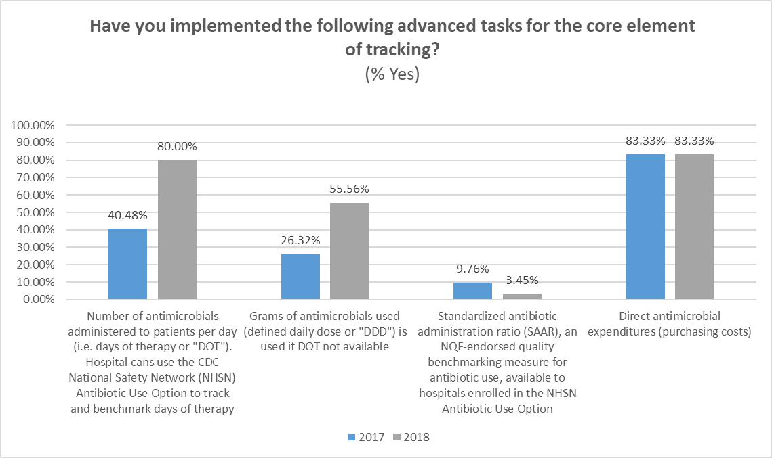
Core Element: Tracking

Slide 14
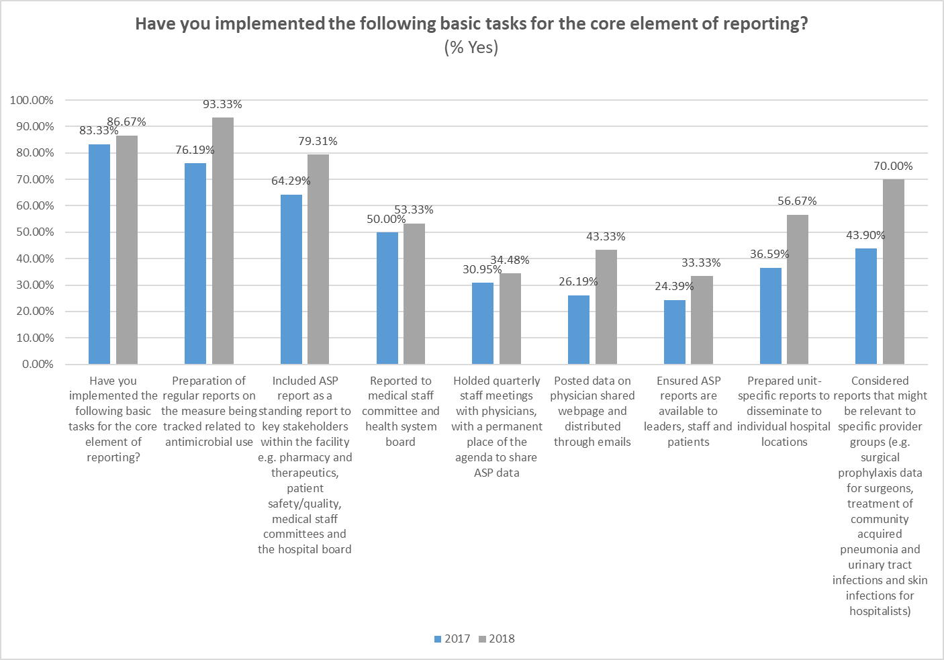
Core Element: Reporting

Slide 15
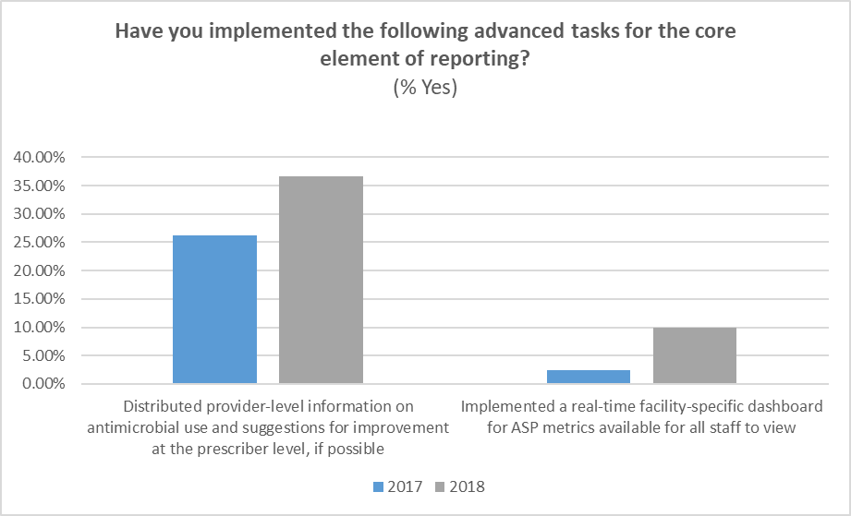
Core Elements: Reporting

Slide 16
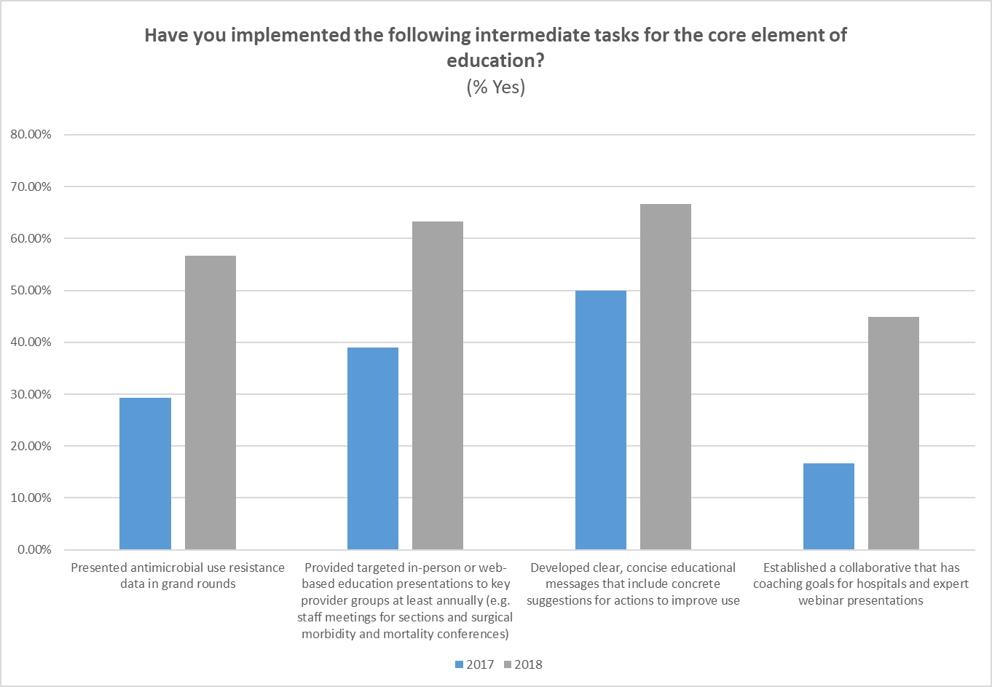
Core Element: Education

Slide 17
Data Updates

Slide 18
Data Review- DOT

Slide 19
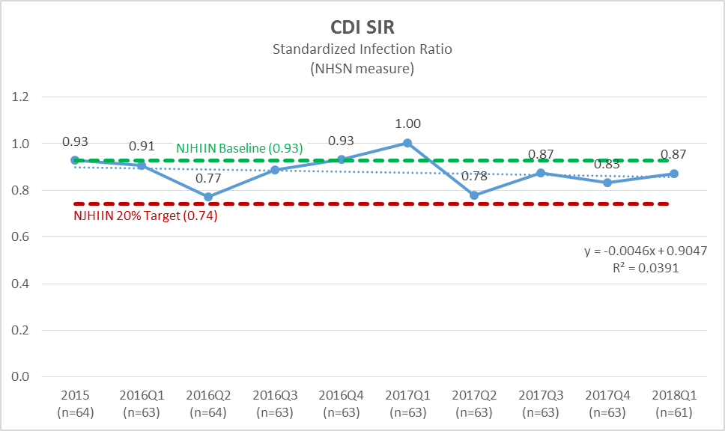
Data Review- CDI SIR

Slide 20
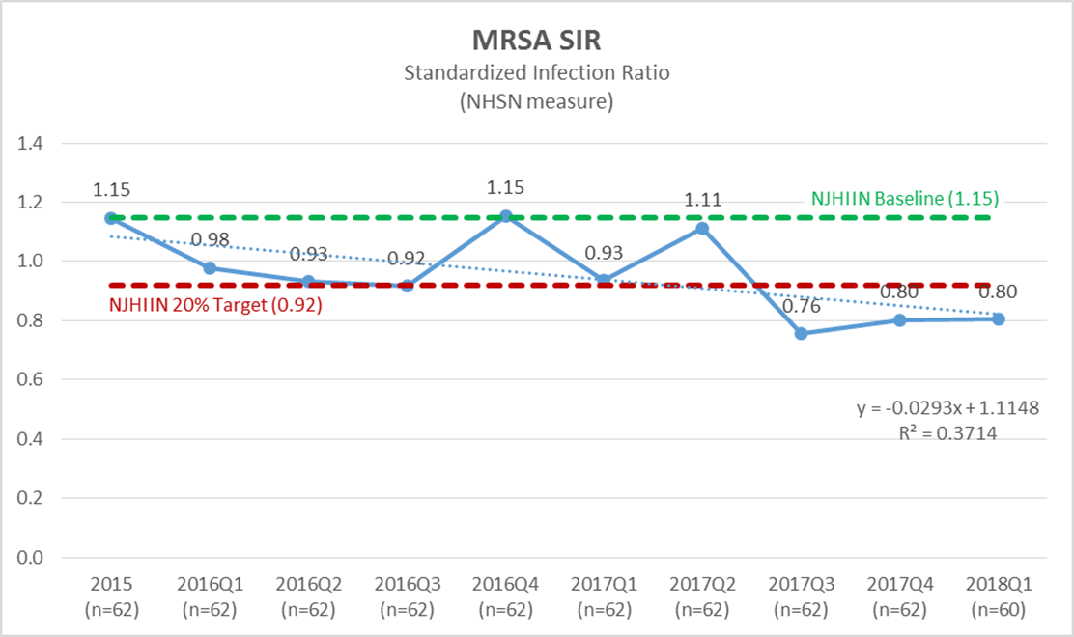
Data Review- MRSA SIR

Slide 21
New Resources That Are Available
APIC:
Manning, et al. APIC/SHEA/SIDP Antimicrobial Stewardship Position Paper. Antimicrobial stewardship and infection prevention—leveraging the synergy: A position paper update. American Journal of Infection Control 46 (2018) 364-8.
IDSA
McDonald, et al. Clinical Practice Guidelines for Clostridium difficile Infection in Adults and Children: 2017 Update by the Infectious Diseases Society of America (IDSA) and Society for Healthcare Epidemiology of America (SHEA) Clinical Infectious Diseases. 2018;66(7):e1–e48.
Miller, et al. A Guide to Utilization of the Microbiology Laboratory for Diagnosis of Infectious Diseases: 2018 Update by the Infectious Diseases Society of America and the American Society for Microbiology. Clinical Infectious Diseases. 2018.

Slide 22
Next Steps - Webinars
NJHA Antimicrobial Stewardship Collaborative
Monthly Webinars 2nd Thursday of each month
Click here to register for webinars
https://njha.webex.com/ under “Institute for Quality and Patient Safety”
Next Webinar August 9 at Noon

Slide 23

http://www.njha.com/pfp/njtools/abx/

