Slide 2
Background
Sepsis is the body's overwhelming and life-threatening response to infection which can lead to systemic inflammation, tissue damage, organ failure and death.
Sepsis continues to be one of the leading causes of death among critically ill people.
Sepsis is often seen in the respiratory system include respiratory tract, gastrointestinal and genitourinary tract.
Often times can worsen pre-existing conditions.
In 2016 - Sepsis cost = $38 billion

Slide 3
Background
Some of the most vulnerable populations at risk for developing sepsis include:
Older adults
Males
People who are immunocompromised
People with chronic conditions
Blacks/African-Americans

Slide 4
Background
Typically older age presents as a risk factor, however, sepsis impacts all ages from newborns to elderly.
Typically, older age is a risk factor, however, sepsis impacts all ages from newborns to the elderly. Unfortunately, sepsis death is reported in higher levels based on issues like income, race and insurance status. That’s why sepsis education is important for all.

Slide 5
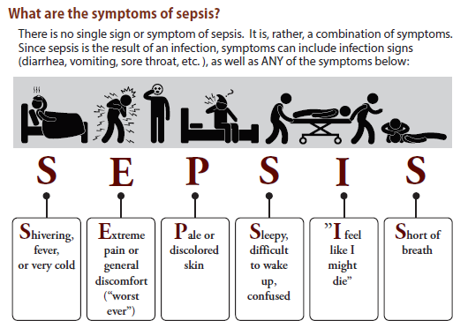
Signs and Symptoms
Notes:
Source: X:\Sepsis Collaborative\NJ Sepsis Legislation\Sepsis Protocols (RWJBHSepsis Education_General 6-18)

Slide 6
Sepsis Self-Management
Taking medications as instructed by your healthcare provider
Eating a healthy diet and drinking enough fluid (water)
Limiting alcohol use
Gradually returning to normal activities as advised by your healthcare provider
Preventing infections by practicing good hygiene
Managing stress in ways such as meditation, breathing exercises and muscle relaxation
Document Released: 07/26/2019 Document Revised: 07/26/2019 Document Reviewed: 07/26/2019 Elsevier Interactive Patient Education © 2020 Elsevier Inc.
Notes:
Source: https://www.elsevier.com/__data/assets/pdf_file/0005/991256/Sepsis,-Self-Care,-Adult_260719.pdf

Slide 7
Take Action
Sepsis is a medical emergency. If you think you or a loved one has sepsis, contact your doctor or medical provider, call 911 or go to the nearest emergency room. Tell the medical provider that you are concerned this may be sepsis. You may even want to bring this brochure with you to help describe the symptoms.
REMEMBER:
1. REPORT symptoms
2. RECEIVE treatment
3. RECOVER quickly

Slide 8
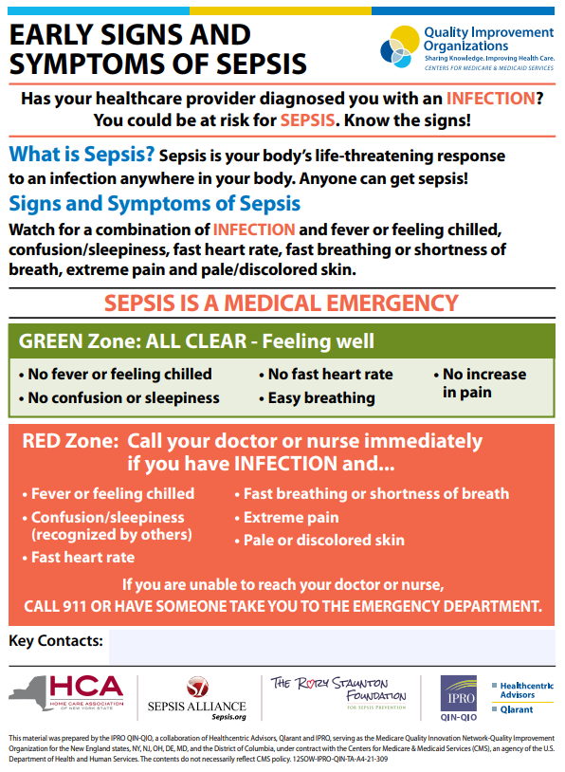
Sepsis Recap
Notes:
Source: https://qi.ipro.org/wp-content/uploads/12SOW-EarlySignsSymptoms-Sepsis_v1.pdf

Slide 9
Resources
http://www.njha.com/CQI/njtools/sepsis/
http://www.njha.com/CQI/njtools/sepsis/ob-sepsis/
NJHA Toolkit for Post-Acute Care Settings
NJHA Sepsis Patient Education
NJHA Sepsis Patient Education (Spanish)
Surviving Sepsis Campaign
Educational resources
Sepsis Alliance
Patient and family resources
Educational resources for Spanish-speaking patients and families
Surviving Sepsis Campaign: International Guidelines for Management of Severe Sepsis and Septic Shock: 2016
Centers for Disease Control and Prevention Sepsis Information

Slide 10
QUESTIONS?

Slide 11
Contact
Sandy Cayo, DNP, FNP-BC
Vice President of Clinical Performance and Transformation
New Jersey Hospital Association
760 Alexander Road, PO BOX 1
Princeton, NJ 08543-0001
Phone: (609) 578-0722
E-mail: scayo@njha.com

