Slide 1
2020-2021 INFLUENZA GUIDANCE
New Jersey Hospital Association

Slide 2
New Jersey Passes New Influenza Legislation
January 2020
P.L. 2019, Chapter 330 mandating annual influenza (flu) vaccination became N.J. law
Requires certain healthcare facilities to offer, and healthcare workers to receive, annual influenza vaccination
The law defines a healthcare facility as “a general or special hospital, nursing home, or home health care agency licensed pursuant to P.L.1971, c.136.”

Slide 3
Law Summary
Each facility must provide annual (either on or off site) flu vaccine for all employees.
Facilities must require that all employees receive an annual flu vaccine between Oct. 1 and Dec. 31 of the current flu season. If an employee does not receive a flu vaccine from their place of employment, they must present acceptable proof and attestation of current record of flu vaccination.
Facilities must maintain a record of attestation of flu vaccines for each employee. Each signed declination statement of employees who do not receive a flu vaccine must be reported to DOH. Each facility must include to the Commissioner and DOH the vaccination percentage rate of its workforce.
Facilities must provide an educational program on influenza vaccination; non-vaccine influenza control measures; and the symptoms, transmission, and potential impact of influenza

Slide 4
Law Summary, cont.
Facilities must conduct an annual evaluation of the program with a goal of improving vaccination rates.
In the event there is a shortage of influenza vaccines, a facility may suspend the annual flu vaccine program as determined by the commissioner.
A healthcare facility shall not discharge or reduce the pay of a healthcare worker who declines to receive an influenza vaccination.
It is the responsibility of the healthcare facility to protect its patients in the event that an employee declines to receive an influenza vaccination, which measures may include, but are not limited to, relocation or change of assignment of healthcare workers.

Slide 5
Next Steps
Please note that NJHA continues to seek clarification from the state on processes related to flu declination. We will provide more updates as they become available.

Slide 6
CDC Recommendations
As flu season approaches, it is essential that healthcare providers and patients maintain and initiate immunizations for preventable diseases.
Routine vaccination is essential for all patients but in particular vulnerable populations including children, pregnant women, immunocompromised individuals and older adults.
Routine vaccinations should not be avoided and delayed especially during the COVID-19 pandemic. Reducing the burden on respiratory illness is essential for healthcare facilities that must continue to prioritize care for acutely ill COVID patients, and also places patients at lesser risks of complications from COVID.

Slide 7
CDC Recommendations, cont.
All facilities should assess vaccination status of each patient during each encounter.
Any vaccines due or overdue should be administered during visit to ensure timely catch-up.
Annual flu vaccine is recommended for all persons 6 months of age and older.
Priority consideration for flu vaccine includes essential workers, persons at increased risk of COVID-19 including older adults, patients with underlying medical conditions, pregnant women, and members of certain racial/ethnic minority groups that have disproportionately been impacted from COVID.
If a patient is suspected or confirmed to have COVID-19, routine vaccines should be deferred until symptoms resolve.
Notes:
https://www.cdc.gov/vaccines/pandemic-guidance/index.html

Slide 8
Influenza Vaccination and Non-Vaccine Control Measures: Symptoms, Transmission, and Potential Impact
Flu is a respiratory illness caused by the human influenza viruses. Two main types that spread among people are Types A and B and are the cause of seasonal flu epidemics.
Per CDC estimates, approximately 3 to 11% of the U.S. population experiences a symptomatic flu illness each year, with an average around 8%.
Infected individuals are most contagious in the first 3-4 days after illness onset. Symptoms arise around day 2 of infection and can remain contagious for up to days 5-7 after that period.
Virus can be spread via tiny droplets – typically released via sneezes, coughs, or even talking.

Slide 9
Influenza Vaccination and Non-Vaccine Control Measures: Symptoms, Transmission, and Potential Impact, cont.
Serious flu complications can result in hospitalization or even death.
Young children, the elderly and individuals with certain health conditions are at a higher risk of serious complications.
An increasing recognition for the need to account for the diversity within the elderly population. Based on a study by the CDC, hospitalization rates for influenza among adults aged 85 years and older were 2 to 6x higher compared to those aged 65-74 years.
During COVID pandemic is it essential that healthcare organizations minimize this risk of inpatient hospital acuity.

Slide 10
Influenza in Acute Care
Promote and administer seasonal influenza vaccine immunization
Take steps to minimize potential exposures
Screen and triage symptomatic patients and implement respiratory hygiene and cough etiquette
Monitor and manage ill healthcare personnel
Consider healthcare personnel at higher risk for complications of influenza
Adhere to standard and droplet precautions
Encourage handwashing and cough covering, social distancing, use labels/signage, provide appropriate PPE if necessary
Use caution when performing aerosol-generating procedures
Manage visitor access and movement within the facility, especially to areas of high immunocompromised patients
Monitor influenza activity and implement environmental infection and engineering control
Train and educate healthcare personnel; administer antiviral treatment and chemoprophylaxis of patients and healthcare personnel when appropriate

Slide 11
Influenza in Post Acute Areas
Successful influenza prevention programs in Skilled Nursing Facilities (SNF), Assisted Living, Dementia Care Homes include:
Immunization
Surveillance
Effective infection control practices
Prompt use of antiviral agents for treatment and prophylaxis
Ensure protection against pneumococcal infections (according to ACIP immunization schedule for adults) in the pre-season phase to help prevent poor outcomes from pneumococcal pneumonia when an individual is also infected with influenza.
Implement Enhanced Standard Precautions by using gown, gloves and performing frequent hand hygiene while caring for residents at increased risk of transmitting infectious agents all year-long, especially during influenza season.

Slide 12
Influenza in Post Acute Areas
SNFs, Assisted Living, Dementia Care Homes must develop plans to accept new admissions during influenza season while maintaining capacity to care safely for other residents. This requires planning for implementing Transmission-Based Precautions and other infection control measures.
Respiratory hygiene/cough etiquette is necessary for all individuals year-long. Influenza virus is transmissible to others for 24 hours before an individual has typical signs and symptoms of influenza. Older individuals and those who are immunocompromised may not present with classical signs of influenza. Containing all respiratory secretions (source containment) at all times is necessary.
Define processes for accepting and transferring residents.
Manage visitors and update visitation policy.

Slide 13
Post Acute Visitation Policy
Limit visitation and exclude ill persons from visiting the facility via posted notices. Consider restricting visitation by children during community outbreaks of influenza.
Healthcare personnel and visitors who are identified with any illness symptoms should be excluded from the facility until their illness has resolved.
Note -- older adults and other long-term care residents, including those who are medically fragile and those with neurological or neurocognitive conditions, may manifest atypical signs and symptoms of influenza virus infection (e.g. behavior change), and may not have fever.
Restrict healthcare personnel movement from areas of the facility having illness to areas not affected by the outbreak.
Administer the current season’s influenza vaccine to unvaccinated residents and healthcare personnel as per current vaccination recommendations.

Slide 14
Influenza in Long Term Care
Vaccination
Key Points ● Increasing vaccination rates ● Legal requirements
Antiviral Treatment
Antiviral Chemoprophylaxis
Testing
Key Points ● When to test and what tests to order
Reporting
When and to whom
Infection Control
Key points • Standard precautions • Droplet precautions • Respiratory hygiene/cough etiquette • Hand hygiene • Enhanced environmental cleaning • Additional infection control tips and prevention measure

Slide 15
Influenza in Home Health
Vaccination
Have a plan in place to monitor employees and patients in home care settings, utilize a checklist
Track whether patients have received an influenza vaccination.
Safely transport vaccines for emergency and short-term transport and storage while in the field.
Staff should use a mask gloves, and other PPE as appropriate
Continue infection control measures to reduce transmission, including following Standard and Droplet Precautions
Immediately report any suspected or new cases as necessary

Slide 16
Influenza in PACE
Vaccination
Implement the established documented infection control plan that ensures a safe and sanitary environment and prevents and controls the transmission of disease and infection.
Monitor staff and patient well-being at each point of contact to maintain responsibility for the care whether delivered by the PACE organization or contractors.
Track whether patients have received an influenza vaccination.
Use remote technology as appropriate, including for scheduled and unscheduled participant assessments, care planning, monitoring, communication, and other related activities that would normally occur on an in-person basis.
Continue providing all required Medicare and Medicaid covered services

Slide 17
Influenza in Hospice
Vaccination
Much higher risk for coming down with the flu
Vital for hospice patients and their caregivers to get the seasonal flu vaccine
Staff should use a mask, gloves and other PPE as appropriate
Continue infection control measures to reduce transmission, including following Standard and Droplet Precautions
Immediately report any suspected or new cases as necessary

Slide 18
Influenza vs. COVID
The World Health Organization recognizes that COVID-19 and influenza viruses have a similar disease presentation.
Both cause respiratory disease, which presents as a wide range of illness from asymptomatic or mild through to severe disease and death.
Both viruses are transmitted by contact, droplets and fomites.
The same public health measures, such as hand hygiene and good respiratory etiquette (coughing into your elbow or into a tissue and immediately disposing of the tissue), are important actions all can take to prevent infection.

Slide 19
Influenza | COVID
Shorter median incubation period than COVID Serial interval is 3 days (spreads faster than COVID) Transmission in the first 3-5 days of illness Children are important drivers | 5-6 day incubation period Transmission 24-48 hours prior to symptom onset Children are less affected Infections: 80% mild or asymptomatic, 15% severe, requiring oxygen; 5% critical, requiring ventilation Preliminary mortality appears higher than influenza

Slide 20
Recommendations
Seek immediate care in ER if you are having signs of shortness of breath, chest pain or difficulty breathing
Contact your healthcare provider to get vaccinated this flu season
Wash hands
Wear a mask
Social distance

Slide 21
New Jersey Respiratory Data
Black patients have the highest percentages of Asthma for all age groups
Asthma is most prevalent in the 5-17 and 18-49 age-groups
COPD/Bronchitis is highest among white patients
COPD/Bronchitis is most prevalent in the 65-80+ age-group
Despite the impact of age, the prevalence of Asthma is high among blacks
Percentage of COPD/Bronchitis cases
34% of white patients are age 65-85+
14% of black patients are age 65-85+
Source: ???

Slide 22
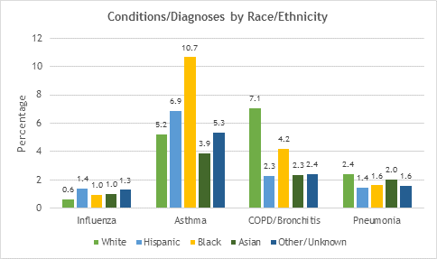
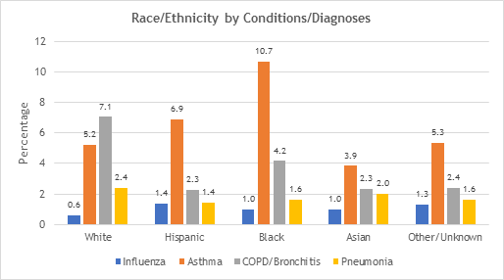
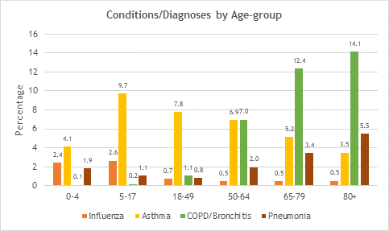
New Jersey Influenza Data
Source: ???

Slide 23
Additional Resources
https://www.cdc.gov/flu/season/faq-flu-season-2020-2021.htm
https://www.cdc.gov/flu/season/health-care-professionals.htm
https://apic.org/Resource_/TinyMceFileManager/consumers_professionals/APIC_IPandYou_YouAreImportant.pdf
https://apic.org/Resource_/TinyMceFileManager/IP_and_You/IPandYou2012/APIC_IPYou2012_LongTermCare_LrgPstr.pdf
https://apic.org/consumers/materials-for-healthcare-facilities/
http://www.sdiz.org/documents/HCP/SDHPII/LTCF-Flu-Toolkit/LTCF_Flu_Toolkit.pdf
https://www.cdc.gov/flu/pdf/professionals/interim-guidance-outbreak-management.pdf
https://www.sfcdcp.org/wp-content/uploads/2018/01/Preventing-Influenza-Outbreaks-in-Long-Term-Care-Facilities-UPDATE-1.6.2017-id1017.pdf
https://www.sfcdcp.org/wp-content/uploads/2018/01/RecommendationsForThePreventionAndControlOfInfluenza_FINAL.pdf
https://professionals.site.apic.org/files/2016/09/Break-the-Chain-of-Infection.pdf

