Slide 1
Notes:
[Organization name] is stepping up to help make sure every resident is counted in the 2020 Census.
The Census Bureau motto is “Everyone counts,” and that’s important to us in our community.

Slide 2
Disclosure
This presentation was prepared using resources from the U.S. Census Bureau and material provided by Advocates for Children of New Jersey.

Slide 3
What is the Census?
The U.S. Census is a national survey that is …
Conducted every ten years
Administered by the U.S. Census Bureau
Constitutionally mandated

Slide 4
Who is counted?
Newborn in the hospital on April 1
Someone living with an unrelated individual
Foster children living with you
A relative without a home and temporarily living with you on April 1
Group Quarters – college dormitories, correctional facilities, nursing homes, group homes, residential treatment facilities, hospice, mental health facilities
The Census is meant to count every living person in the U.S. – citizens, non-citizens, individuals who were formerly incarcerated, newborns and children … EVERYONE!

Slide 5
Not sure if you included everyone?
You can complete the questionnaire a second time, the same as before, but this time you will add individuals who were missed.
The Census Bureau will later remove any duplicates.
Submit your corrected response online or over the phone using your address or the original code mailed to you by the Census Bureau.

Slide 6
What You Need to Know
Between March 12-20, households will receive an invitation to respond online to the 2020 Census. Households may also receive paper questionnaires.
Between March 16-24, households will receive a reminder letter.
For households not responding, a reminder postcard will be sent between March 26 and April 3.
Another reminder letter and paper questionnaire will be sent between April 8-16.
Between April 20-27, final reminder postcards will be mailed before in-person follow up begins.

Slide 7
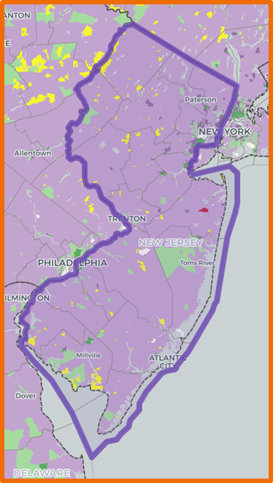
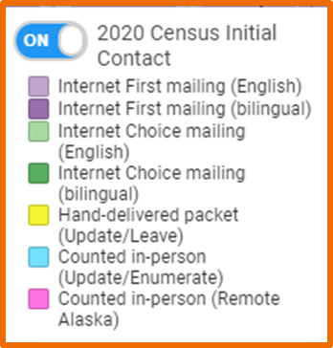
2020 Census Initial Contact
Notes:
Internet First - these households will initially receive an invitation in the mail to complete their Census online or over the phone (purple)
Internet Choice - these households will first receive an invitation in the mail to complete their Census online or over the phone, as well as a paper form (green)
Update/Leave - Census workers will hand deliver a packet to these households, which will include a paper form as well as instructions on how to complete the Census online or over the phone (yellow)

Slide 8
What You Need to Know
Questions include name, age, gender, race/ethnicity and relationship to head of household of each person living in the home in addition to owner/renter questions
Census will NEVER ask for financial information, Social Security numbers, credit card or banking information or donations
Federal law protects the confidentiality of all personal information.
Don’t confuse Census 2020 with the American Community Survey.
It’s not just about a head count!
Notes:
It’s important to stress that all Census information is confidential.
It’s also important that individuals know that the Census will never ask for financial information, Social Security numbers, credit card or banking information. If you have questions or concerns, contact the Census Bureau at 1-800-991-2520.

Slide 9
Language Support
Spanish
Chinese
Vietnamese
Korean
Russian
Arabic
Tagalog
Polish
French
Haitian Creole
Portuguese
Japanese
Hard copy form is available in English and Spanish
Additional assistance through the Bureau’s language guides for 59 different languages.
Notes:
The Census Bureau will provide language guides for 59 different languages; hard copy forms are available in English and Spanish.

Slide 10
Assistance with Questionnaire Responses
Yes … and No
Create an environment for individuals that ensures privacy and confidentiality.
Refer someone to the response method that best suits them.
If you provide assistance you should inform them you are not a Census Bureau employee and their responses will not be protected by Federal law.
Check the Census Bureau’s Fact Sheet:
“Questions and Answers for Stakeholders Supporting the 2020 Census”

Slide 11
Reassure the Community
Questions include name, age, sex, race/ethnicity and relationship to head of household of each person living in the home – other questions as well…but the Census will NEVER ask for financial information, Social Security numbers, credit card or banking information.
Federal law protects the confidentiality of all personal information.
Census workers are certified to act in their capacity
Wear a photo ID with U.S. Department of Commerce watermark and expiration date
If you are unsure, contact the Census Bureau Regional Office:
1-800-991-2520

Slide 12
What are Group Quarters?
The Census Bureau classifies all people not living in housing units as living in group quarters.
Group quarters include nursing homes, skilled-nursing facilities, residential treatment centers, in-patient hospice facilities, psychiatric hospitals.
Non-institutional group quarters include religious group living quarters, workers’ group living quarters, college or seminary residence halls or other apartment-style housing where residents may enter into “by the bed” leases.
Census enumerators will work with administrators to determine the method of counting residents.
Notes:
The Census counts everyone, once, only once, and in the right place. College dorms, prisons, military barracks, and long-term nursing homes are examples of Census group quarters.
The Census will work with administrative staff at these places to count everyone.
Students or military personnel living in apartments will receive their own Census mailings.
Everyone should answer their Census form based on where they usually reside as of April 1, 2020.

Slide 13
What are Hard-to-Count Groups?
A Hard-to-Count population refers to areas where a low percentage of households returned their 2010 Census forms.
Populations considered harder to count than others include
Children under 5
Individuals of color
Individuals who do not speak English
Immigrants
Individuals who rent
Homeless
Individuals suffering from addiction or mental health issues
Individuals who live in complex households
Notes:
Unfortunately, we know there are some segments of our population that are considered hard to count, including:
children under the age of 5
individuals of color
those who do not speak English
immigrants
renters
the homeless
people who suffer with addiction or mental health issues, and
individuals who live in complex households.
Again – everyone counts! – and we want to make sure those vulnerable individuals are counted and that our community receives the necessary federal funds to provide the programming and support services they are entitled to.

Slide 14
Interactive maps of local hard-to-count areas available at: www.census.gov/roam

Slide 15
Did you know that Census counts are used to decide where to spend federal funding for New Jersey’s hospitals, post-acute providers, community agencies, schools and infrastructure?
Notes:
An accurate count is important to make sure the people of our community receive their full share of federal funds and programming. The Census count affects support for programs including NJ FamilyCare, student loans, the school lunch program, Head Start and other programs affecting health and social services.
All told, nearly $23 billion in federal funding for New Jersey is linked to the Census.

Slide 16
Why is this important?
An accurate count ensures proper funding for hard-to-count populations (ex: people with disabilities, people experiencing homelessness)
Critical federally-funded programs are guided by the Census (ex: healthcare, food and nutrition, housing, education, employment)

Slide 17
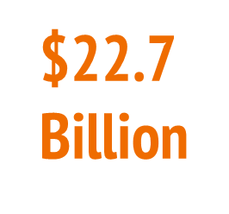
Annual Federal Funding Received by NJ
NJ FamilyCare*: | $9.6B
Medicare Suppl. Medical Ins. (Part B): | $2.9B
Federal Direct Student Loans: | $1.7B
National School Lunch Program: | $261M
Head Start: | $164M
Child Care: | $120M
Health Care Centers: | $78M
*Includes Medicaid and State Children’s Health Insurance Program (SCHIP)
Notes:
As we mentioned before, NJ received 22.7 billion dollars through important federal programs in FY 2016. The George Washington Institute of Public Policy (GWIPP) serves as a university-wide nexus for faculty and graduate students engaging in research on important public policy issues. One of their researchers, George Reamer published a study Counting for Dollars 2020: The Role of the Decennial Census in the Geographic Distribution of Federal Funds
As directed by Congress, over three hundred federal spending programs rely on data derived from the Decennial Census to guide the geographic distribution of funds to states, counties, cities, and households. To better understand the fiscal impacts of the upcoming 2020 Census on states and local areas, the Counting for Dollars Project aims to:
identify each federal program that geographically distributes financial assistance based, in whole or part, on data derived from the Decennial Census; and
ascertain the connection between Decennial Census accuracy and the equitable distribution of funds to states and local areas.
And here are a few of the of the programs that ACNJ has highlighted that rely on Census data to allocate funds. These are important federal programs and they all depend on Census data.

Slide 18
Did you know that Census counts help determine New Jersey’s number of seats in the House of Representatives, its number of votes in the electoral college, and our voting district boundaries? It’s more than just a head count!
Notes:
The number of N.J. representatives in the U.S. Congress also is based on the Census.

Slide 19
COUNT ME IN!

Slide 20
10 Years is a Long Time!
Notes:
As a healthcare provider, we’re taking several steps to help make sure everyone counts in the 2020 Census: [use whichever apply]
We’re assisting in the count of people who may be in our care for extended periods in so-called “group quarters” such as nursing homes, inpatient hospice or psychiatric hospitals.
We’re training staff to assist any patients or residents who may need help completing their Census questionnaire. (We aren’t allowed to answer the questions for them, but we can provide assistance if they need it. When we provide assistance, we will advise/remind patients or residents that we are not Census Bureau employees.)
We’re working with other groups and partners in our community to help reach individuals in those hard-to-count groups and make sure they are represented.
We consider the U.S. Census an important part of our commitment to population health and inclusion for all members of our community.

Slide 21
ACNJ Census Page (contains toolkit): www.census2020nj.org
Interactive maps:
CUNY Hard-to-Count Maps: www.censushardtocountmaps2020.us
Census ROAM: www.census.gov/roam
Apply for Census jobs: https://2020census.gov/en/jobs.html
Census Bureau Outreach Resources: https://2020census.gov/en/partners/outreach-materials.html
Statistics in Schools: https://www.census.gov/schools/
Resources

