Slide 1
Outpatient Antibiotic Stewardship Updates
July 25, 2018
Andrew Miller, MD, MPH
New Jersey Task Lead, Outpatient Antibiotic Stewardship
Quality Insights Quality Innovation Network

Slide 2
Quality Insights Quality Innovation Network Outpatient Antibiotic Stewardship Project Overview
Start/end dates: October 1, 2016 – July 31, 2019
Recruitment targets met by July 31, 2017
Goal: Participants will incorporate all four Outpatient Core Elements by December 31, 2018
60% to meet goal by July 31, 2018
80% to meet goal by December 31, 2018

Slide 3
Quality Insights Quality Innovation Network Outpatient Antibiotic Stewardship Project Status
 | Target | Actual
Practices/Providers Recruited by 7/3/17 | 250 | 493
Practices/Providers Meeting All Core Elements of Outpatient Antibiotic Stewardship by 12/31/18 | 200 | 221 (as of 7/11/18)

Slide 4
Project Partnerships
Collaboration with:
New Jersey Hospital Association
New Jersey Department of Health
Renal Network 3
Centers for Disease Control and Prevention (CDC)
Multidisciplinary Advisory Group
Patient and Family Advisory Group

Slide 5
Types of Outpatient Settings for This Project
Physician practices
Federally-Qualified Health Centers (FQHCs)
Outpatient clinics
Urgent care centers
Emergency departments
Outpatient pharmacies
Outpatient pharmacy-based clinics
Dialysis facilities

Slide 6
Outpatient Antibiotic Stewardship: Differences from Institutional Settings
Type of inappropriate use of antibiotics
Prescribing when not necessary
Patient expectations
More need for education of patients
Amount of time it takes to not prescribe rather than prescribe
Level of control over prescribers
No oversight by infectious disease specialists, pharmacists, or infection control specialists
Less opportunity for education of prescribers?

Slide 7
CDC Core Elements of Antibiotic Stewardship
Core Elements of Hospital Antibiotic Stewardship | Core Elements of Outpatient Antibiotic Stewardship
Leadership Commitment | Commitment
Accountability
Drug Expertise
Action | Action for Policy and Practice
Tracking | Tracking and Reporting
Reporting
Education (of clinicians) | Education and Expertise (of patients and clinicians)
https://www.cdc.gov/antibiotic-use/healthcare/implementation/core-elements.html
https://www.cdc.gov/antibiotic-use/community/improving-prescribing/core-elements/core-outpatient-stewardship.html

Slide 8
QIN Strategies for Implementing the Core Elements

Slide 9
Quality Insights Quality Innovation Network Published Resources
Resources available through My Quality Insights:
Welcome packet
Posters/flyers
Patient handouts
Educational handouts for nurses
Videos
Toolkit
Webinars and recorded e-learns
Bi-monthly newsletters, updates, and alerts

Slide 10
Quality Insights Quality Innovation Network Published Resources
Welcome Packet
Posters/flyers
Patient handouts
Educational handouts for nurses
Videos
Toolkit
Webinars and recorded e-learns
Bi-monthly newsletters, updates, and alerts

Slide 11
Quality Insights Quality Innovation Network Published Resources
Welcome packet
Posters/flyers
Patient handouts
Educational handouts for nurses
Videos
Toolkit
Webinars and recorded e-learns
Bi-monthly newsletters, updates, and alerts
Updates, and Alerts

Slide 12
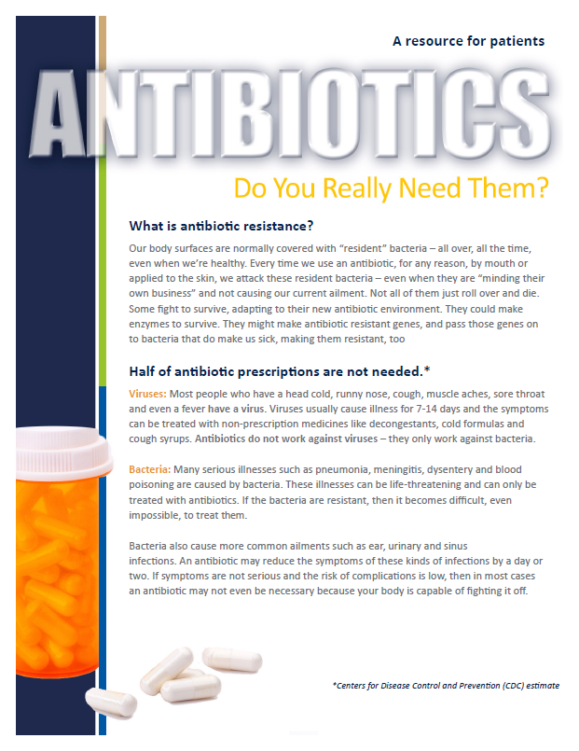
Quality Insights Quality Innovation Network Published Resources
Welcome packet
Posters/flyers
Patient handouts
Educational handouts for nurses
Videos
Toolkit
Webinars and recorded e-learns
Bi-monthly newsletters, updates, and alerts
Alerts

Slide 13
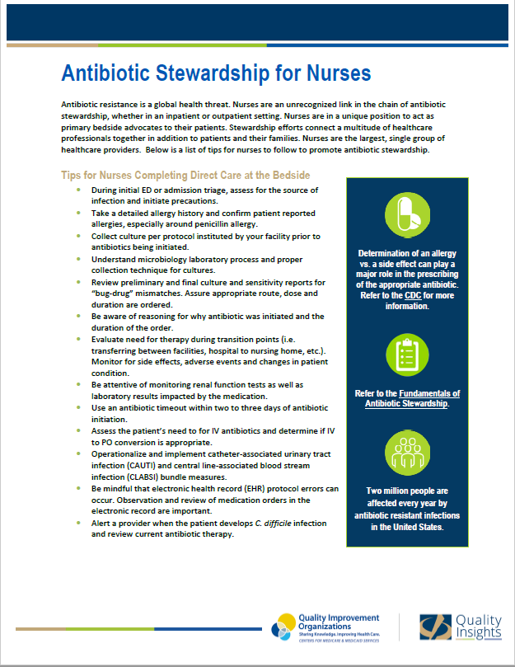
Quality Insights Quality Innovation Network Published Resources
Welcome packet
Posters/flyers
Patient handouts
Educational handouts for nurses
Videos
Toolkit
Webinars and recorded e-learns
Bi-monthly newsletters, updates, and alerts

Slide 14
Quality Insights Quality Innovation Network Published Resources
Welcome packet
Posters/flyers
Patient handouts
Educational handouts for nurses
Videos
Toolkit
Webinars and recorded e-learns
Bi-monthly newsletters, updates, and alerts

Slide 15
Antibiotics: The Right Tool for the Right Problem
https://www.youtube.com/watch?v=iLitefsTHTA&feature=youtu.be

Slide 16
Quality Insights Quality Innovation Network Published Resources
Welcome packet
Posters/flyers
Patient handouts
Educational handouts for nurses
Videos
Toolkit
Webinars and recorded e-learns
Bi-monthly newsletters, updates, and alerts

Slide 17
Quality Insights Quality Innovation Network Published Resources
Welcome packet
Posters/flyers
Patient handouts
Educational handouts for nurses
Videos
Toolkit
Webinars and recorded e-learns (CEUs available for many)
Bi-monthly newsletters, updates, and alerts

Slide 18
QIN Webinars/Mini-Webinars
Antibiotic Stewardship: Ready, Set, Go
Top 10 Reasons Patients Want an Antibiotic and the Art of Saying No
The Role of the Pharmacist in Antibiotic Stewardship (mini-webinar)
Out of the Starting Gate: Successes and Challenges of Implementing Outpatient Antibiotic Stewardship
The ED Physician and Antibiotic Stewardship (mini-webinar)

Slide 19
QIN Webinars/Mini-Webinars
The Role of Vaccines in the Fight against Antimicrobial Resistance (mini-webinar)
I Have a Cold and Need an Antibiotic: Treatment Guidelines for URIs in the ED (mini-webinar)
Penicillin Allergy: What You Don’t Have Can’t Hurt You (mini-webinar)
It Hurts to Pass Urine: Treatment Guidelines for UTIs in the ED (mini-webinar)
2018 Core Elements Workout: Commitment and Education/Expertise Strengthening Outpatient Antibiotic Stewardship

Slide 20
QIN Webinars/Mini-Webinars
Help! My Legs are Red: Treatment Guidelines for Skin Infections in the ED (mini-webinar)
Nurse’s Role in Outpatient Antibiotic Stewardship
Strengthening Outpatient Antibiotic Stewardship: Action
Strengthening Outpatient Antibiotic Stewardship: Tracking/Reporting

Slide 21
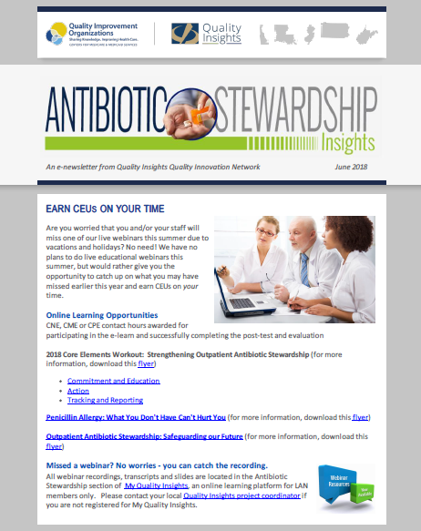
Quality Insights Quality Innovation Network Published Resources
Welcome packet
Posters/flyers
Patient handouts
Educational handouts for nurses
Videos
Toolkit
Webinars and recorded e-learns
Bi-monthly newsletters, updates, and alerts

Slide 22
CDC Resources
Outpatient Antibiotic Stewardship webpage: https://www.cdc.gov/antibiotic-use/community/improving-prescribing/outpatient-stewardship.html
Includes resources for both patients and health care professionals

Slide 23
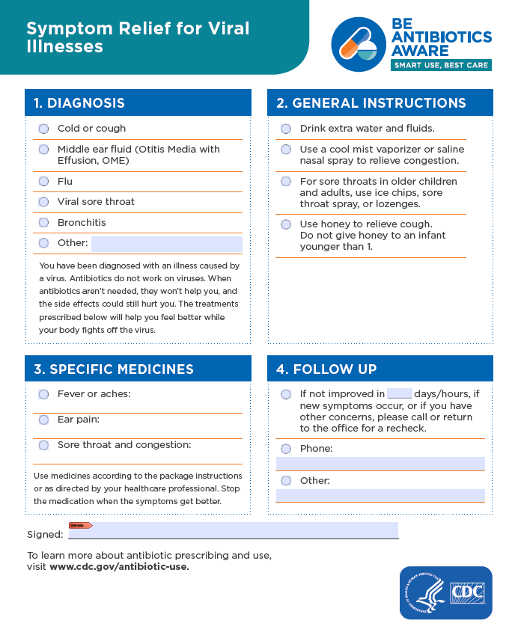
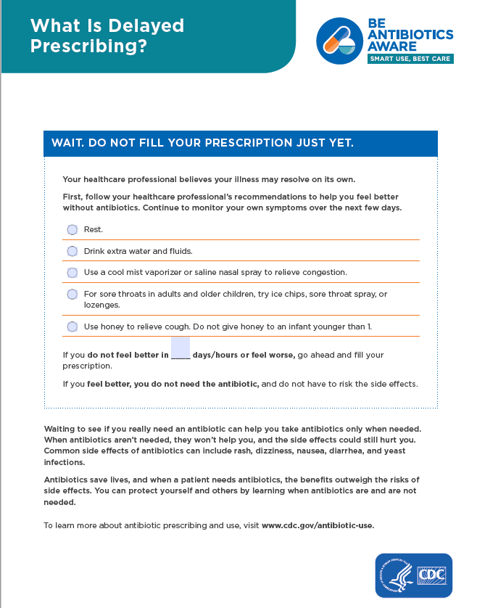
CDC Resources
A number of the CDC Resources are also available through My Quality Insights

Slide 24
CDC Resources
Video - Your Role in Using an Antibiotic: Be a Partner in Your Healthcare – 8’30”
https://qioprogram.org/antibiotic-stewardship-resources

Slide 25
Actions to Improve Outpatient Antibiotic Prescribing
From Checklist for Core Elements of Outpatient Antibiotic Stewardship:
Use evidence-based diagnostic criteria and treatment recommendations
Use delayed prescribing practices or watchful waiting, when appropriate
Provide communications skills training for clinicians
Require explicit written justification in the medical record for non-recommended antibiotic prescribing
Provide support for clinical decisions
Use call centers, nurse hotlines, or pharmacist consultations as triage systems to prevent unnecessary visits
http://www.hqi.solutions/wp-content/uploads/2017/10/HQI_Revised-Checklist-for-Core-Elements-of-OAS.pdf

Slide 26
QIN-Supported Tracking Reports State, Corporate, Individual Practitioners
Antibiotic prescribing reports: Prescriptions per 1,000 patients per month

Slide 27
QIN-Supported Tracking Reports State, Corporate, Individual Practitioners
Reports of antibiotic prescribing for specific conditions:
Bronchitis
Pharyngitis
Sinusitis

Slide 28
Other Analyses for Tracking Outpatient Antibiotic Prescribing
Appropriate antibiotic prescribed
e.g. narrow vs. broad spectrum
Appropriate dose
Appropriate duration
Appropriate de-escalation

Slide 29
Thank You
Andrew Miller, MD, MPH
New Jersey Task Lead, Outpatient Antibiotic Stewardship
andy.miller@area-J.hcqis.org
732.238.5570, Ext. 2072
This material was prepared by Quality Insights, the Medicare Quality Innovation Network-Quality Improvement Organization for West Virginia, Pennsylvania, Delaware, New Jersey and Louisiana under contract with the Centers for Medicare & Medicaid Services (CMS), an agency of the U.S. Department of Health and Human Services. The contents presented do not necessarily reflect CMS policy. Publication number QI-C3-NJ-071818

