Slide 1

A Development Program for Front Line Nurse Manager Preceptors
Mary Anne Marra, DNP, RN, NEA-BC
Chief Nursing Officer

Slide 2
Objectives
  Discuss the process utilized to develop the nurse manager preceptor program
  Review the measurement of pre-program and post-program change in leadership skills
  Examine the implementation of the preceptor model with a small test of change with a new nurse manager
  Present the nurse manager orientation tools developed during the program

Slide 3
Definitions
Front Line Nurse Manager (FLNM)
  Responsible for 24 operations of one or more units for patient care delivery
  Challenges of current healthcare environment, (Heller, Esposito-Herr, Tom, 2004)
Preceptor
  Facilitates acquisition of skills for role
    Student
    Entry level practitioner
    Advance Practice (McClure and Black, 2013)
Notes:
Front line nurse manager responsible for functions such as
Hiring of staff
Human resource management
Competency assessment
Review of job performance
Discipline
Termination
Financial management of care delivery
Budget preparation
Budget implementation
Variance Review
Development of highly productive teams, delivery of quality patient care, customer and staff satisfaction,.
Healthy Work environment
Current Challenges of healthcare environment,
High vacancy and turnover rates
Higher acuity level of patients
Limited financial resources of healthcare organizations
Technology (Heller, Esposito-Herr, Tom, 2004)
Quality of care

Slide 4
Background and Significance
Significance of the Role of Nurse Manager
  Development of effective work team
  Create and sustain healthy work environment
    Outcomes
      Patient safety
      Customer Satisfaction
      Staff Satisfaction
  Increase in organizational effectiveness
  (Sherman and Pross, 2010), (Warshawsky, Rayens, Stefaniak and Rahman, 2013), (Baxter and Warshawsky, 2014).
Notes:
Three components that highlight the critical role of the FLNM:
Staff nurse satisfaction is linked to their relationship with their manager
Future nursing leadership comes from development of middle managers
Nurse Manager satisfaction and longevity is currently at an all-time low and needs to be improved to attract and retain nurses in this critical role. (Makoff, 2011)
FLNMs now have responsibility to:
sustain the quality of care delivered, assure patient safety
establish goals, develop innovation
assure efficiency and fiscal responsibility for the delivery of care. (Balasco Cathcart, Greenspan and Quinn, 2010).
Stability in of high performing managers in the front line management level increases organizational effectiveness (Makoff, 2011).

Slide 5
Nurse Manager Transition to Role
The lack of a formal mechanism to orient new FLNM to the role impacts on:
  Properly prepare FLNM for the responsibilities
    Quality and Safety
    Resource Allocation
    Customer Service (Bressler and Fisher, 2012)
    Daily decisions regarding the cost of care delivery (McLarty and McCartney, 2009)
  Lack of FLNM engagement in the role and lead to job dissatisfaction and turnover

Slide 6
Identifying Preceptor Participants
FLNM Preceptors recruited from four acute care hospitals in New Jersey
  Letter mailed to CNOs of acute care hospitals
  Participant deemed a competent NM, to serve as preceptor
Acute Care Hospitals NJ
  Have a FLNM that meets the criteria for participation
  3 years or more experience in the role.
  Competent as per Benner’s model
    nurse who has been in the same job for 2-3 years,
    has the ability to consider long-term goals as they relate to actions
    gains perspective based on conscious, abstract and analytical thinking regarding the problem.
CNO’s in New Jersey have identified need for FLNM development (Cadmus and Johansen, 2012)

Slide 7
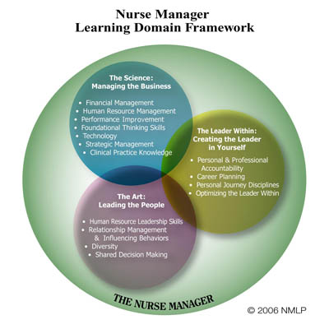
AONE Framework
Healthcare Leadership Alliance Competency Model, (Stefl, 2008)
Nurse Manager Leadership Collaborative, AONE, AACN, AORN, Learning Domain Framework (Fennimore and Wolf, 2011)
Essentials of Nurse Manager Orientation

Slide 8
Program Objectives
Create an FLNM Preceptor Training Program
  Develop FLNM preceptors for their role.
  Build upon competency as FLNM
  Build upon constructs of the Essentials of Nurse Manager Orientation
  Objectives:
    Increase FLNM preceptors’ ability to translate ENMO concepts into organizational specific practice and performance metrics as measured through pre and post program self-assessment utilizing the Nurse Manager Skills Inventory.
    Increase CNO evaluation of the FLNM preceptor skills as measured by pre and post program rating of the FLNM preceptor by the CNO utilizing the Nurse Manager Skills Inventory.
    Evaluate the congruence between the pre and post evaluation of the FLNM preceptor skills as reported in the Nurse Manager Skills Inventory assessment by the FLNM preceptor and the CNO.
    Demonstrate application of ENMO in the clinical setting as measured by the implementation of a financial skills project at the completion of the didactic session on the finance competency.
    Analyze the FLNM preceptors evaluation of the program.

Slide 9
Theoretical Framework
Patricia Benner
Novice to Expert
  Novice
  Advanced Beginner
  Competent
  Proficient
  Expert
As new FLNM assumes the new role they enter at the level of Novice
Competent manager a preceptor as per Benner definition
  nurse who has been in the same job for 2-3 years
  has the ability to consider long-term goals as they relate to actions
  gains perspective based on conscious, abstract and analytical thinking regarding the problem.
This helps the nurse to achieve greater efficiency and organization in the performance of tasks. ( Benner, 1984)

Slide 10
Literature Review
Search conducted using CINAHL, Medline and Business Source Primer databases
Concepts of
  1) the relationship of the nurse manager role to quality outcomes and staff satisfaction
  2) nurse manager competencies and nurse manager development
  3) preceptors in nurse development and nurse manager preceptors
Manager Strong performance
  Critical Thinking (Zori, Nosek and Musil, 2010)
  Transformational Leadership Style (Casida and Parker, 2011).
  Positive work environment for staff and
  Improved outcomes (Boev, 2012)

Slide 11
Literature Review
Types of nurse manager leadership development programs
  Weekly informational meetings paired with peer coaching over a six month period (Codier, Kamikawa, and Molina Kooker, 2011)
  A nurse manager orientation program (Cohen, 2013)
  An online portal providing a repository of information for FLNMs (Parry, et. al., 2012)
  Didactic sessions to educate about leadership skills (Maryniak, 2011) A leadership development program for nurse managers based upon the Nurse Manager Leadership Domain of AONE (Fennimore and Wolf, 2011)
  A yearlong program including:
    a 4 day workshop
    mentoring support over a one year period
    organizational support to implement leadership projects in the healthcare setting (McPhee, et. al., 2011)

Slide 12
Literature Review
Preceptors
  Other nurse managers
  Chief Nursing Officers
  Directors of Nursing
  Peer coaching (Hawkins, Carte and Nugent, 2009)
Preceptors must be competent to provide guidance(Palumbo, Rambur and Boyer, 2012)
Benner, Novice to Expert
  Found to be a framework to structure nurse manager development from novice to expert

Slide 13
Methods
Setting and Target Population
  FLNM who are competent, based upon Benner (1984) definition
    Competent manager a preceptor as per Benner definition
      nurse who has been in the same job for 2-3 years
      has the ability to consider long-term goals as they relate to actions
      gains perspective based on conscious, abstract and analytical thinking regarding the problem.
    FLNM who is person of choice to serve as preceptor for new FLNMs in the organization
Four 8 hour didactic sessions
  Build on the constructs of the Essentials of Nurse Manager Orientation© (ENMO©) online program ( AONE, 2013)
  Prepare list and collate organizational documents, policies and procedures, forms to assist nurse manager during orientation.
Small test of change project
  Preceptors work with a new nurse manager in their respective organization on a change project, “Lead Your Team” constructs

Slide 14
Methods and Data
Pre and Post program assessment
  Nurse Manager Skills Inventory©
    Preceptor, pre, post program and two months post program completion
    Preceptor manager, pre and two months post program completion
    Nurse Manager Orientee, pre and post small test of change project
  Leadership Practices Inventory©
    Preceptor, pre and post program
    Nurse Manager Orientee, pre and post small test of change project
Demographic data collected on
  FLNM Preceptor
  New FLNM
  CNO
  Organization

Slide 15
Framework
Essentials of Nurse Manager Orientation© (AONE)
Patricia Benner (1984)
  Novice to Expert

Slide 16
Project Activities
Approval from the Rutgers University IRB for the implementation of the project.
Develop a curriculum for training of FLNM preceptors based upon the ENMO content.
  Expand on the ENMO orientation content
    Discussion of specific examples of application of the principles within the organizations of the participants
    Organizational specific documents
      Policies
      Procedures
      Forms
      Anecdotal examples

Slide 17
Project Activities
Recruitment of Participants
  Recruited from 4 acute care hospitals
  Letter mailed to acute care hospital CNOs
    One successful recruitment
  Personal emails to two CNOs
    One successful recruitment
    One un-successful for recruitment
      Concerned about time commitment for the participation in the program for a nurse manager
    One connection through director of education to CNO
  Telephone interviews with CNOs to discuss program and confirm commitment
    CNOs identified nurse manager participants
    CNOs agreed to pay tuition for ENMO curriculum
  Telephone interviews with participants to discuss program participation, ENMO program and data requirements
  Email communication to establish best dates for program meetings.

Slide 18
Project Activities
Participants completed modules of the ENMO
Four 8 hour didactic meetings, November 15, 18 and December 5 and 13th.
Discussion of the ENMO topics
Discussion and brainstorming of list of “items” needed for a nurse manager orientation
  Developed into list to of items to be collated into orientation book
Discussion of activities for a new nurse manager to complete during orientation
  Developed into Nurse Manager Orientation Checklist

Slide 19
Evaluation Plan
Methods/Indicators
  Demographics
  Nurse Manager Skills Inventory
    Change over time pre and post program by the
      Preceptor
      Manager
      Manager orientee
    Comparison of Preceptor and Manager evaluation
  Leadership Practices Inventory
    Change over time pre and post program
      Preceptor
      Manager Orientee
  Project Implementation by preceptor with new FLNM
    Lead the People project completed by new manager with preceptor
  Post program evaluation by completed by the preceptor

Slide 20
Demographics
 | Preceptor | CNO | Orientee
Age | Range 45-54 Median= 50.5 | Range 30-45 Median= 34.0 | Range 58-59 Median= 58
Sex | F = 4 M= 0 | F = 3 Male = 1 | F = 4 Male= 0
Ethnicity | Asian = 1 Black/African American= 2 White = 1 | Asian = 1 Black/African American = 1 White = 2 | White = 4
Years as Registered Nurse | Range 21-32 years Median= 22 years | Range 8-24 years Median = 8 years | Range 36-39 years Median= 37.0
Months/Years as Nurse Manager/CNO | Range 6-28 years Median= 10.29 years | Range 2.5 months to 4 years Median = 5.5 months | Range 4-17 years Median= 6.04
Months/Years in current position | Range 3-6.5 years Median= 5.25 years | Range 2.5 months- 9 months Median = 0.46years | Range 1.4 -10 years Median= 4.13 years
Highest level of nursing education( select one below) | BSN = 2 MSN= 1 MS other = 1 | BSN = 3 MSN= 1 | MSN= 2 MS other= 1 DNP=1
Certification, Yes/No | Yes= 3 No = 1 | Yes = 3 No = 1 | Yes = 4
Title of Certification | CNML= 1 Oncology Nurse= 1 Gerontology Nurse =1 |  | NE-BC = 1 NEA-BC= 2 CPHQ= 1
Number of years certified | Range 1.5 to 9 years Median= 3.0 years | Range 1-6 years Median= 4.0 years | Range 5-23 years Median= 10.5 years

Slide 21
Demographics
 | Preceptor | Orientee
Previous Experience Orienting Nurse Managers | Yes= 3 No= 1
Number of manger oriented | Range 3-6
Oriented to role of manager |  | Yes= 1 No= 2 One participant did not respond
Duration of Orientation |  | 2.5 months Only one participant responded

Slide 22
Organizational Demographics
Organization Demographics
Hospital Type: | Not for profit = 4 Teaching = 2 Non-teaching = 2
Licensed beds | Range 178-651 beds
Number of Maintained beds | Range = 155-500
Magnet Designated | Yes = 3 No = 1
On Magnet Journey | No = 1
Pathway to Excellence Designated | No = 4
On Pathway to Excellence Journey | Yes = 1 No = 3
Number of Front Line Nurse Managers (FTEs) | Range 8-26 Mean = 18
Number of Front Line Nurse Manager vacancies | Range 0-1 Mean= 0.25
Number of Front Line Nurse Managers hired in the past two years | Range 3-8 Mean = 4.75
Formal Orientation for Front Line Nurse Managers | Yes = 2 No = 2
Duration of formal orientation for FLNM | Range 3-12 weeks

Slide 23
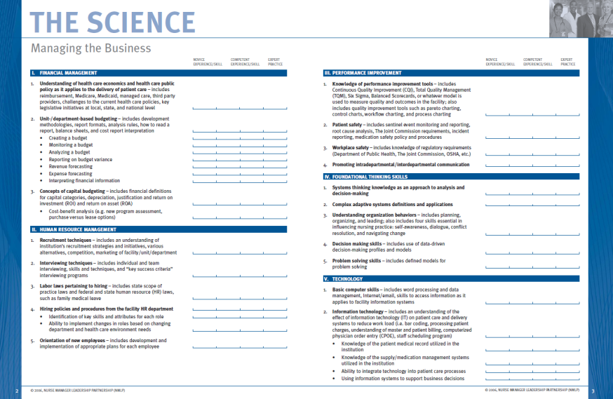
Nurse Manager Skills Inventory
American Association of Critical Care Nurses (2006), retrieved from: http://www.aacn.org/wd/practice/docs/nurse-manager-inventory-tool.pdf

Slide 24
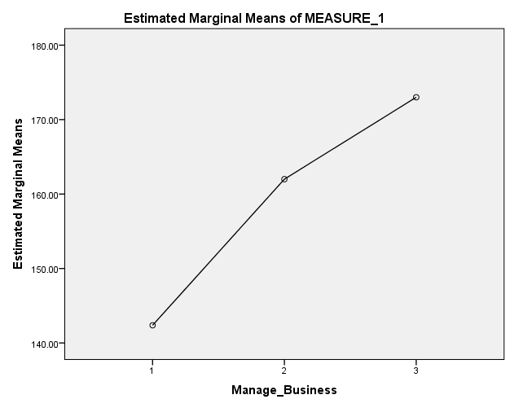
Nurse Manager Skills Inventory©
Score Change by Preceptors
Manage the Business
Time 1, Time 2 and Time 3
Mean Score

Slide 25
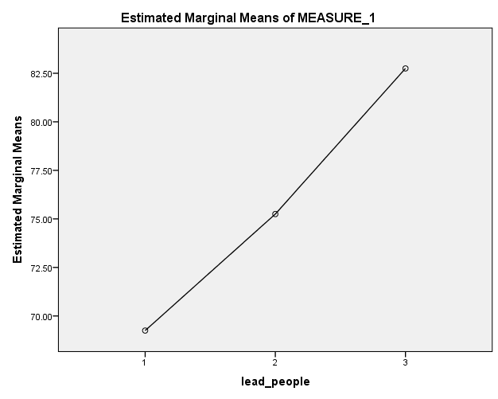
Nurse Manager Skills Inventory©
Score Change by Preceptors
Lead the People
Time 1, Time 2 and Time 3
Mean Score

Slide 26
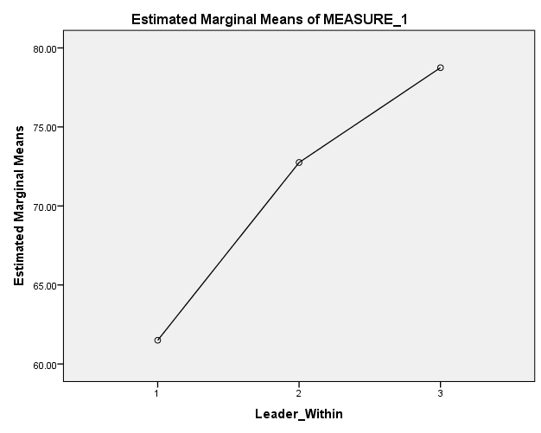
Nurse Manager Skills Inventory©
Score Change by Preceptors
Creating the Leader Within Yourself
Time 1, Time 2 and Time 3
Mean Score

Slide 27
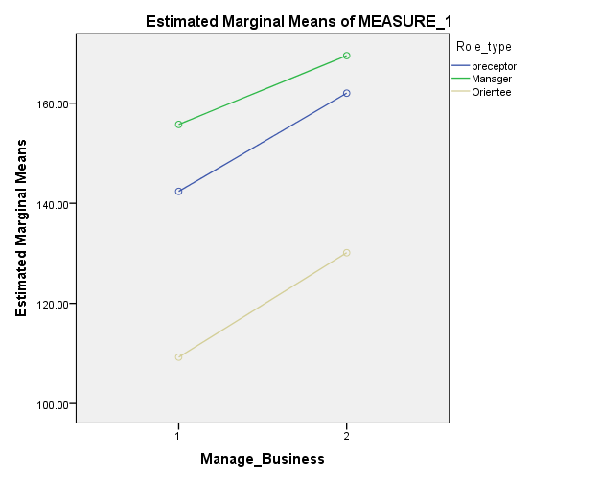
Nurse Manager Skills Inventory©
Score change by role
Manage the Business
Time 1 and Time 2
Mean Score

Slide 28
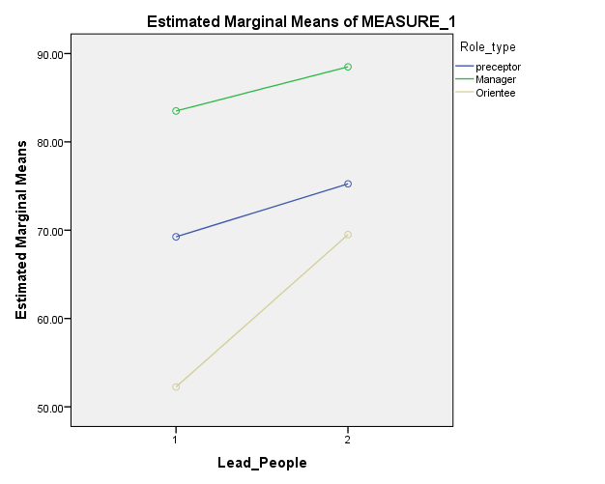
Nurse Manager Skills Inventory©
Score change by role
Lead the People
Time 1 and Time 2
Mean Score

Slide 29
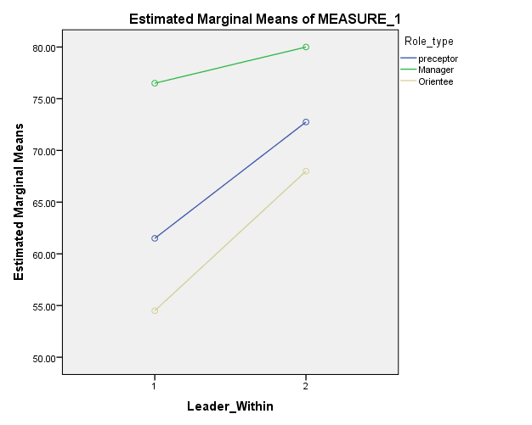
Nurse Manager Skills Inventory©
Score change by role
Creating the Leader Within Yourself
Time 1 and Time 2
Mean Score

Slide 30
Nurse Manager Skills Inventory©
Domain | Subsection | Potential Maximum Score | Mean T1 | Mean T1
Managing the Business | Financial Management | 55 | P = 33.88 M = 36.50 O = 21.63 | P = 40.00 M = 41.50 O = 26.00
 | Human Resource Management | 35 | P = 25.13 M = 30.00 O = 18.75 | P = 27.50 M = 32.75 O = 21.50
 | Performance Improvement | 20 | P = 14.00 M = 15.75 O = 11.25 | P = 15.25 M = 17.00 O = 13.25
 | Foundational Thinking Skills | 25 | P = 16.25 M = 19.00 O= 14.00 | P = 19.00 M = 20.00 O = 16.50
 | Technology | 30 | P = 21.75 M = 22.75 O = 19.00 | P =23.50 M = 24.75 O = 22.75
 | Strategic Management | 45 | P = 27.63 M = 27.75 O = 21.88 | P = 32.75 M = 29.00 O = 27.13
 | Appropriate Clinical Practice Knowledge | 5 | P = 3.75 M = 4.00 O = 2.75 | P = 4.00 M = 4.50 O = 3.00

Slide 31
Nurse Manager Skills Inventory©
Domain | Subsection | Potential Maximum Score | Mean T1 | Mean T1
Leading the People | Human Resource Leadership Skills | 25 | P = 17.75 M = 20.75 O = 13.50 | P = 19.75 M = 22.50 O = 16.75
 | Relationship Management and Influencing Behaviors | 45 | P = 29.75 M = 36.25 O = 22.00 | P = 31.25 M = 37.50 O = 29.50
 | Diversity | 15 | P = 10.50 M = 13.75 O = 8.75 | P = 12.00 M = 14.50 O = 11.75
 | Shared Decision Making | 10 | P = 7.75 M = 8.50 O = 5.75 | P = 8.25 M = 9.50 O = 8.00

Slide 32
Nurse Manager Skills Inventory©
Domain | Subsection | Potential Maximum Score | Mean T1 | Mean T1
Creating the Leader in Yourself | Personal and Professional Accountability | 20 | P = 14.00 M = 17.00 O = 12.25 | P = 16.25 M = 17.00 O = 15.00
 | Career Planning | 15 | P = 10.25 M = 12.50 O = 8.75 | P = 12.25 M = 12.75 O = 10.50
 | Personal Journey Disciplines | 15 | P = 10.00 M = 12.00 O = 8.00 | P = 12.00 M = 13.50 O = 10.75
 | Reflective Practice Reference Behaviors/Tenants | 45 | P = 30.75 M = 39.75 O = 28.75 | P = 36.25 M = 41.50 O = 35.75

Slide 33
Preceptor and Manager Comparison
Managing the Business Time 1 Preceptor/Manager Score
Managing the Business Time 2 Preceptor/Manager Score

Slide 34
Preceptor and Manager Comparison
Leading the Team Time 1 Preceptor/Manager Score
Leading the Team Time 2 Preceptor/Manager Score

Slide 35
Preceptor and Manager Comparison
Creating the Leader in Yourself Time 1
Preceptor/Manager Score
Creating the Leader in Yourself Time 2
Preceptor/Manager Score

Slide 36
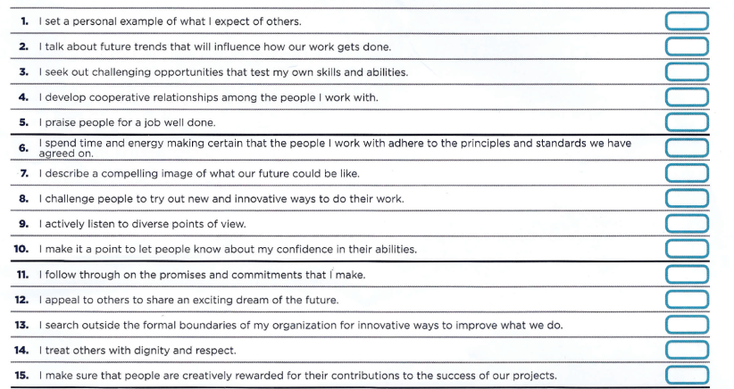
Leadership Practices Inventory
“How frequently do I engage in the behavior described?”1) almost never, 2) rarely, 3) seldom, 4) once in a while, 5) occasionally, 6) sometimes, 7) fairly often, 8) usually, 9) very frequently, 10) almost always
Kouzes, J. and Posner, B. (2013), retrieved from: http://www.leadershipchallenge.com/UserFiles/LPISelfSampleReport-Aug2013.pdf, used by permission

Slide 37
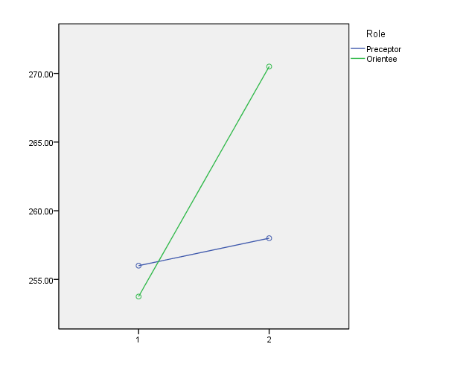
Leadership Practices Inventory©
Change over time
Preceptor and Orientee
Time 1 and Time 2
Mean Score

Slide 38
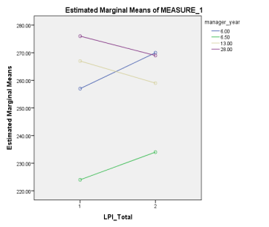
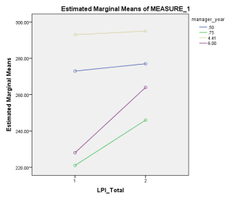
Leadership Practices Inventory©
Preceptor
LPI Total
Change T1 to T2
Orientee
LPI Total
Change T1 to T2
Mean Score
Mean Score

Slide 39
Leadership Practices Inventory©
Exemplary Leadership Practice | Total Possible Score | T1 | T2 | Change in Mean
Model the Way | 60 | P =52.75 O = 50.00 | P = 52.75 O = 54.50 | P = 0 O = 4.5
Inspire a Shared Vision | 60 | P = 51.5 O = 50.50 | P = 51.75 O = 52.50 | P = 0.25 O = 2.0
Challenge the Process | 60 | P = 49.25 O = 50.00 | P = 50.25 O = 53.75 | P = 1.0 O = 3.75
Enable the Way | 60 | P = 51.00 O = 50.75 | P = 54.25 O = 54.50 | P = 3.25 O = 3.75
Encourage the Heart | 60 | P = 51.50 O =52.25 | P = 49.25 O = 55.50 | P = -1.25 O = 3.25

Slide 40
Program Evaluation
Five-point Likert scale, strongly agree, agree, neither agree or disagree, disagree, strongly agree:
  The program has increased my understanding of the nurse manager skills.
  The program has increase my ability to present concrete examples of nurse manager skills to a nurse manager orientee.
  The program has increased my confidence to serve as a nurse manager preceptor.
  The program has increase my confidence in my role and performance of my job as a nurse manager.
  Overall I found this program helpful to my role as a nurse manager preceptor.
  ALL Strongly Agree

Slide 41
Comments
“I wish I had this course when I became a new manager.”
“It was a great review for me as a manager with many years of experience. I have found I can never say you know it all. It helped to clarify some areas like finance that I may be weak and to reinforce areas that I may be doing really well. Thanks for the opportunity to be a part of a very needed tool for new nurse managers.”
“This program validated, taught, and has given me a better idea/insight to do a more thorough job in orientating new nurse managers.”
“This program gave me the opportunity not only to learn to precept a new manager, but also to evaluate where I am as a Leader and see areas where I am doing well and I can make some improvements. Thank you for this privilege.”

Slide 42
The Front Line Nurse Manager Preceptor Assignment with a Front Line Nurse Manager
Principles and Elements of a Healthful Practice/Work Environment (AONE, 2004)
  Collaborative Practice
  Improving Communication
  Accountability
  Qualified nurses
  Leadership
  Shared Decision making
  Growth and Development
  Valuing nursing
  Meaningful recognition

Slide 43
Six Month Action Plans
Collaborative Practice
  monthly staff meetings with discussion of goals and outcomes for the unit
  shared governance reports at staff meetings
  discussion among unit leadership of progress toward unit goals and staff strengths and weaknesses
  meeting with departments leaders of other departments to develop relationship for mutual goals that impact patient flow
  a detailed and specific plan to work with other departments to establish a video EEG program
Improving Communication
  holding 1:1 staff meetings with all staff members
  implementing an open door policy for staff
  establishing a unit communication board, providing staff with education tools to improve communication
  surveying staff members of preferred method of communication
  establishing a communication tree for staff in the staff lounge
  implementing TeamSTEPPS strategies of briefings and huddles daily on the unit
Developing Accountability
  involving staff in the development and review of the unit staffing plan
  assessing staff involvement in bedside shift report
  increasing staff accountability to manage attendance and punctuality through manager coaching
  involving staff in an improvement process to decrease undocumented medications
  providing staff with freedom to collaborate with other staff members for task completion

Slide 44
Six Month Action Plans
Staff involvement-qualified nurses
  Encouraging staff self-scheduling and time trading to decrease absenteeism
  improving communication with charge nurses to increase comprehension of the staffing budget
  flexing of unit staffing based upon patient acuity
Leadership
  to be fair and respectful when interacting with staff
  to work to better understand personal strengths and weaknesses and then continue to build leadership skills
  to attend leadership development programs
  to work toward a transformational leadership style
Shared decision making
  encouraging staff input for unit decision making
  support active unit council
  work with staff to develop goals for the unit
  share data with staff (NDNQI) and share information from nursing councils, PI, Patient Satisfaction and Professional Practice Council

Slide 45
Six Month Action Plans
Growth and development
  encourage staff to attend classes offered by the organization and to seek national certification
  cross train staff to other positions
  develop a succession plan
  encourage professional organization participation
  encourage staff to attend formal education for advancement and flex schedule for school attendance
Valuing nursing
  assuring unit participation in all of the nursing department councils
  developing a functioning shared governance model on the unit
  providing staff time to attend council meetings
  encourage staff to attend hospital-wide committees

Slide 46
Six Month Action Plans
Meaningful recognition
  creating a reward system for staff
  implement an appreciation board on the unit
  encourage staff to nominate others for awards
  develop a unit based employee of the month program, encourage peer nominations for the hospital employee of the month and the Daisy award
  acknowledge staff accomplishments at staff meetings
  send personal thank you notes to staff
  acknowledge staff personally for patient comments on nurse manager rounds and satisfaction surveys
  unit based celebrations of birthday, life events and holidays
  “caught in the act” recognition of staff for positive customer feedback
  “Hearts of Healing “unit board for staff recognition

Slide 47
Program Outputs
Nurse Manager Orientation Document list
Nurse Manager Orientation Checklist
Meet and Greet Checklist
FLNM preceptors to bring tools back to organization
  Orient new managers

Slide 51
Limitations
Program size
  4 preceptor participants
Program duration
  Measure of impact to future nurse managers in the participating organizations

Slide 52
Future Considerations
FLNM preceptors to bring tools back to organization
  Benefits to Program Participants
  Orient new managers
Training additional FLNM preceptors in the future
  Repeat the program with additional nurse manager preceptors
  Add to the ENMO content of AONE

Slide 53
Questions

Slide 54
References
American Organization of Nurse Executives. (2012). Essentials of Nurse Manager Orientation; . retrieved from; http://www.aacn.org/wd/elearning/content/enmo/enmohome.pcms?menu=elearning
American Association of Critical Care Nurses (2006), retrieved from: http://www.aacn.org/wd/practice/docs/nurse-manager-inventory-tool.pdf
Balasco Cathcart, E., Greenspan, M., & Quinn, M. (2010). The making of a nurse manager: the role of experiential learning in leadership development. Journal of Nursing Management, 18, 440-447.
Benner, P. (1984). From Novice to Expert, Excellence and Power in Clinical Nursing Practice. Menlo Park, California: Addison-Wesley Publishing Company.
Boev, C. (2012). The Relationship Between Nurses' Perception of the Work Environment and Patient Satisfaction in Adult Critical Care. Journal of Nursing Scholarship, 44, 368-375.
Bressler, T.&Fisher, M. (2012), Leading Into the Future. Nursing Management, November, 10-12.
Cadmus, E., & Johansen, M. L. (2012). The Time is Now: Developing a nurse manager residency program. Nursing Management, 43, 18-24.
Casida, J., & Parker, J. (2011). Staff nurses perceptions of nurse manager leadership styles and outcomes. Journal of Nursing Management, 19, 478-486.
Codier, E., Kamikawa, C., & Molina Kooker, B. (2011). The Impact of Emotional Intelligence Development on Nurse Managers. Nursing Administration Quarterly, 35, 270-281.
Fennimore, L., & Wolf, G. (2011). Nurse Manager Leadership Development, Leveraging the Evidence and System-Level Support. Journal of Nursing Administration, 41, 204-210.
Hawkins, A., Carter, K., & Nugent, M. (2009). Nurse Manager Orientation. AACN Advanced Critical Care, 20, 55-70.
Kouzes, J. and Posner, B. (2013), retrieved from: http://www.leadershipchallenge.com/UserFiles/LPISelfSampleReport-Aug2013.pdf, used by permission

Slide 55
References
Mackoff, B. L. (2011). Nurse Manager Engagement. Sudbury: Jones and Bartlett Publishers.
MacPhee, M., Skelton-Green, J., Bouthillette, F., & Suryaprakash, N. (2011). An empowerment framework for nursing leadership development: supporting evidence. Journal of Advanced Nursing, 68, 159-169.
Maryniak, K. (2013). Development of Training for Frontline Nurse Leaders From Assessment to Results. Journal of Nurses in Professional Development, 29, 16-18.
McLarty, J. & McCartney, D. (2009). The Nurse Manager the Neglected Middle. Healthcare Financial Management, August, 74-80.
Palumbo, M., Rambur, B. A., & Boyer, S. A. (2012). Education and Employment Characteristics of Nurse Preceptors. The Journal of Continuing Education in Nursing, 43, 472-480.
Parry, J., Calarco, M. M., Hensinger, B., Kearly, G., & Shakarjian, L. (2012). An Online Portal to Support the Role of the Nurse Manager. Nursing Economics, 30, 230-232.
Shirey, M. R. (2007). Competencies and Tips for Effective Leadership, from Novice to Expert. Journal of Nursing Administration, 37, 167-170.
Zori, S., Nosek, L. J., & Musil, C. M. (2010). Critical Thinking of Nurse Managers Related to Staff RNs' Perceptions of the Practice Environment. Journal of Nursing Scholarship, 42, 305-313.
Zwink, J. E., Dzialo, M., Fink, R. M., Oman, K. S., Shiskowsky, K., Waite, K., et al. (2013). Nurse Manager Perceptions of Role Satisfaction and Retention at an Academic Medical Center. Journal of Nursing Administration, 43, 135-141.

